Slide 1


Software Development Project on
MEDICS
In partial fulfillment of
Bachelor’s of Computer Applications (BCA)
Gujarat university (2022-2023)
(Third year of the bachelor of computer applications)
Project created by:
Group number:- 02
Bhavik Manwani [55]
Dhrumil Karia [40]
Dhruv Pandya [68]
Lokmanya College of Computer Applications (LCCA)
Shivranjani cross road, 132 feet Ring road,
Satellite, Ahmedabad-380008
Contact:- (079)-26920259

Slide 2


Acknowledgment
We have taken efforts in this project however, it would not have been possible without the kind of support and help of many individuals. We would like to extend our sincere thanks to all of them.
We are highly indebted to Prof. Sejal Vaghela for their guidance and constant supervision as well as for providing necessary information regarding the project. We take this opportunity to thank all of our friends who provided extremely useful reviews and for their all-time support and help in every aspect of the course of the project preparation. We are grateful to our college, Lokmanya College of Computer Applications, Ahmedabad for providing us with all the required resources and a good working environment.
Finally, we would like to thank everyone who directly or indirectly helped us in this project, With thanks to all.

Slide 3
SHOP
MEDICS
One stop for all medical requirements.
By:-
Bhavik Manwani 55
Dhruv Pandya 68
Dhrumil Karia 40

Slide 4
Index
PAY
Organization Profile
1
Details about the organization supporting this project
Introduction
2
Details and definition about the project
Project Profile
3
3.1 Existing System
3.2 Proposed System
3.3 Development Tools and Tech
4
Screen Layout
3.1 Customer
3.2 Vender
3.3 Admin

Slide 5
Index
Report Layout
5
6
Conclusion
7
Bibliograpgy
PAY
Details about the references used

Slide 6
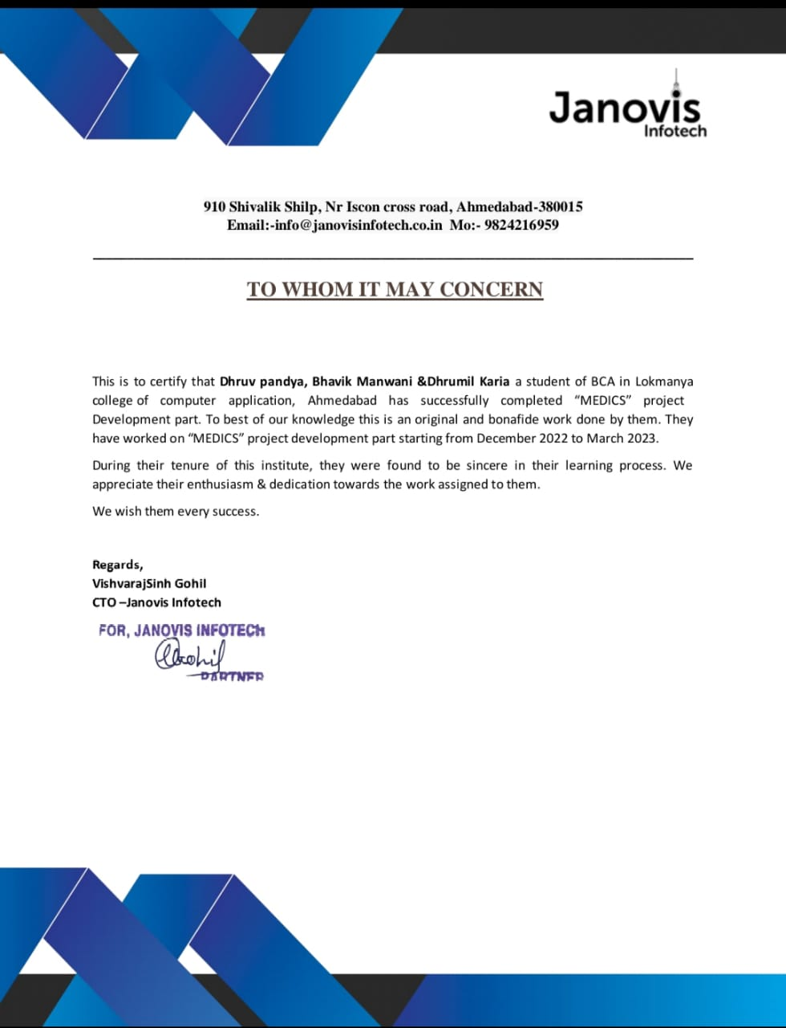

ORGANIZATIONAL
PROFILE
Janovis Infotech
Company Name: | Janovis Infotech
Address: | 910 Shivalik Shilp, Iskcon cross road, Ahmedabad-380008
Email-Id: | info@janovisinfotech.co.in
Contact Number: | +91 90169 10353
Website: | http://www.janovisinfotech.co.in

Slide 7
Introduction
Nowadays we witness a phase of transition of buying patterns of any goods, clothes, electronics, furniture, etc. With the advent of technology, offline shopping switched to online mode. Buying anything online is fashion
Medics is an Online Pharmacy, and it is going to be the next big evolution that will impact billions of lives and bring a healthy behavioral change to safer and more convenient tomorrow.
While many aspects of healthcare service delivery, like finding doctors or hospitals, booking appointments, payment of fees, booking lab tests, and viewing lab tests, have gone online; pharmacy is one area that still lags.

Slide 8
Definition
The application of the internet to access drugs and diagnostics which begin early in the advent of the info age has matured into portals or virtual drug stores popularly known as “Internet Pharmacy” or “Online Pharmacy” or “Web Pharmacy” or “Cyber Pharmacy”.
E-Pharmacies are online platforms where consumers can purchase medicines without having to visit brick-and-mortar pharmacies. This makes the process more convenient for consumers and has resulted in a rising demand for the model across the world.
In addition, increasing utilization of e-Prescription in hospitals globally, it has also led to the growth of this industry.

Slide 9






Key Players of e-Pharmacy
Netmeds
Medplus
Pharmeasy
Davaindia
Apollo Pharmacy
1Mg

Slide 10
Types:
The Market-place model
The Inventory based model
Where e-pharmacy is the online service of a licensed pharmacy.
Where a technology company connects neighborhood licensed pharmacies to the end user
Organized Pharmacies
Non organized e-Pharmacy
Types
In this model, prescription medicines are ordered without any prescription. There is no check on the genuineness of the order due to the absence of qualified pharmacists. Also, improper record keeping and no audit are the major areas of concern.

Slide 11





Inventory Based Model
Inventory-based e-commerce means an activity where the inventory of goods and services is owned by the e-Commerce entity and is sold to customers directly.
Website
Customer
Licensed Pharmacy

Slide 12


Market-place Model
Market place model of e-commerce means providing an information technology platform by an e-commerce entity on a digital and electronic network to act as a facilitator between buyer and seller.
Operates under
IT Act
Licensed Pharmacy 1
Operates under the drugs & cosmetics act
Licensed Pharmacy 2
Consumers
Website or
mobile platform
Licensed Pharmacy 3

Slide 13
Components of e-Pharmacy
Technology
Web-based or mobile-based application for consumer transmits their prescriptions and place request for medicines.
Order that is received verified and checked by a registered pharmacist.
The registered pharmacists forward the verified prescription to the pharmacy store from where the medicines are dispensed by a licensed pharmacy.
The web or mobile-based platforms are governed under the IT Act 2000.

Slide 14
Pharmacy retail store
The registered pharmacist at the store verifies the prescription before dispensing it.
The medicines are dispensed from the licensed premises to the patient.
An Invoice with batch number of medicines dispensed, expiry date, name, and address of the pharmacy with the signature of the registered pharmacist is issued online.

Slide 15
How do Medics Operate?
2. Capture Prescription
3. Search nearby Pharmacies
4. Check availability of Medicines
5. Fill your order with Prescription
6. Pay online
7 .Receive your order at your Door Step
1. Customer
MEDICS

Slide 16














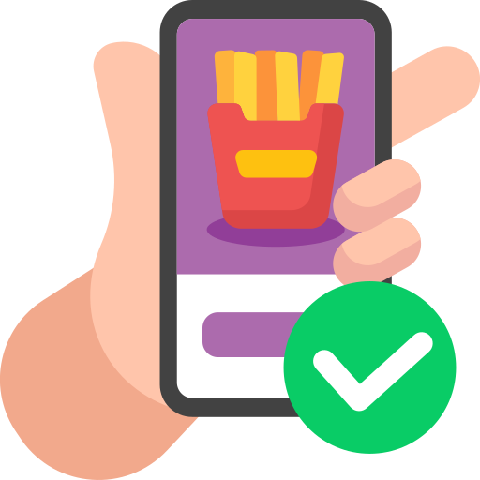


Customer
Platform
Licensed Pharmacy
Practitioner
Order Received
Prescription Received
Registered
Pharmacist Checks
Order Canceled xx
Registered
Pharmacist Checks
E-Prescription
Hard Copy
Prescription available
Valid Prescription
Uploads
Prescription
Scans
Prescription
Valid Prescription
Medicines dispensed by the registered pharmacy to Patient’s Agent in sealed pack with retail invoice.
Place Order
Forwards valid prescription to licensed pharmacy retail store.
The Patient’s agent distributes the sealed pack to the consumer.

Slide 17
How it Works.
Sign-up
Add to Cart
4
Sign-up and upload your prescription.
1
Add health products, devices and aids to the Cart
Select
5
Review
Select Product from our Store.
2
Review your order and savings!
Upload
6
Payment
Our pharmacist reads,
re-writes/transcribes and readies your medicines
3
Pay securely through Cash-On-Delivery, Credit/Debit Card or Internet Banking

Slide 18
InterConnection
Pharmacies
Medics
Customer
SERVICES

Slide 19
Medics Process
01
04
Check Availablity
Delivery Process
The store owner updates the stock of products on the website.
After uploading the valid prescription user gets the product delivered to their doorstep effortlessly.
01
04
MEDICS PROCESS
02
02
03
03
Never Out-Of-Stock
Easily Available
Users can get every required product very conveniently at their doorstep.
As Medics is based on market place model, the adversity of out-of-stock will never arise.

Slide 20
Project Profile:
3.1 Existing System
3.2 Proposed System
3.3 Development Tools and Tech

Slide 21
Project Profile:
Project title | MEDICS
Group no. | 02
Group members | Bhavik Manwani [55] Dhrumil Karia [40] Dhruv Pandya [68]
Internal guide | Prof. Sejal Vaghela
External guide | Vishvaraj sinh Gohil
Front-end | Python 3.10, Vs Code 1.71
Back-end | MySQL 8.0.30

Slide 22



Existing System
Time Consuming
May prove to be time consuming for the elderly and busy scheduled peoples.
01
Fixed Time
availability
02
Remains open for fixed time and fixed days of the week
Inconvinient
03
03
Chronic elderly patients who are not able to go to pharmacy store may cause difficulty
Slower Distribution
04
The Supply chain is slower

Slide 23





Price
05
The price of drugs is more than online pharmacy medicines due to middle mans profit
Less Reliable
06
Less Realiable compare to e-pharmacy
Lesser Range
of choice
07
07
Has Limited range of choices in Medicines and other supplies
Not Private at all
08
Consumer’s Information is not confidential

Slide 24
Proposed System
• It is very easy to order prescription drugs through E-Pharmacy. Especially for people who live far away from a traditional pharmacy, the elderly, disabled people, and those who work very intensively, this system is both a very easy and a very fast method of obtaining medicine. Additionally, the shipping cost is much cheaper than traveling to a traditional pharmacy.
• One of the most important advantages of the E-Pharmacy application is time-saving. You can order your medication within minutes and get your prescription medicines very quickly. All you have to do is to place an order by entering the prescription through the mobile application or website. You do not have to go to the pharmacy and you will not be faced with waiting in line at the pharmacy.
• E-Pharmacy, which offers a much wider range of options than a traditional pharmacy, provides a great advantage to patients. It is not possible to find every drug in a physical pharmacy in a particular area, but there are many more drug options available in general drug stores.

Slide 25
Proposed System
The online pharmacy is the most convenient and quick shop from where the consumer can quickly get medicines over the internet. Online pharmacy is also termed e-pharmacy or internet pharmacy or mail-order pharmacy.
Online pharmacy provides a mobile-based application for consumers, where they can upload scanned copies of the prescription and easily place their requests for medicine.

Slide 26
02
03
01
04
Discounted rates: wider reach, reduced operational cost, reduced labor cost, and ability to provide a pocket-friendly deal on the medicines to your customers.
Range of choices: E- pharmacy has more extensive stocks of medicine than conventional pharmacies; it offers a huge variety of options. Therefore, it is guaranteed that you can get any medicine that you are searching for.
Convenient: Online pharmacy serves a convenient way of buying medicine for old age, physically challenged and working professionals, due to the difficulty for them to go local medical shop.
Anytime anywhere: You can place your order anytime from anywhere as there is no issue with the pharmacy closing down. 24*7 online customer supports are there to solve your queries regarding medicines.
SHOP

Slide 27




06
07
05
Systematic: Online stores have the process of drug approval, before dispatching the medicines to the consumer they require a prescription which is reviewed by a qualified pharmacist.
Easy secured payments: Online pharmacy provides the facility of cashless payments either by credit or debit card, Paytm or you can also pay by cash on delivery.
08
Information is private and confidential: The information that you have provided during the purchase of medicine is usually private and confidential in an online pharmacy. This approach is beneficial for those people who feel embarrassed or shameful to speak face to face about conditions like erectile dysfunction, acne, STDs, and hair loss.
Facilitate useful information: Online pharmacy websites provide beneficial information regarding drug interaction and side effects of medicine in the form of product facts, blogs, or articles.
SHOP

Slide 28
Tools And Technology
We use below technologies for our MEDICS
Framework | Django 4.0
Front-end | Python 3.10
Back-end | MySQL 8.0.30
For Code Editing Purpose | VS Code 1.7.1
Server (Live) | Apache HTTP Server

Slide 29
Screen Layout
3.1 Admin
3.2 Vendor
3.3 Customer

Slide 30
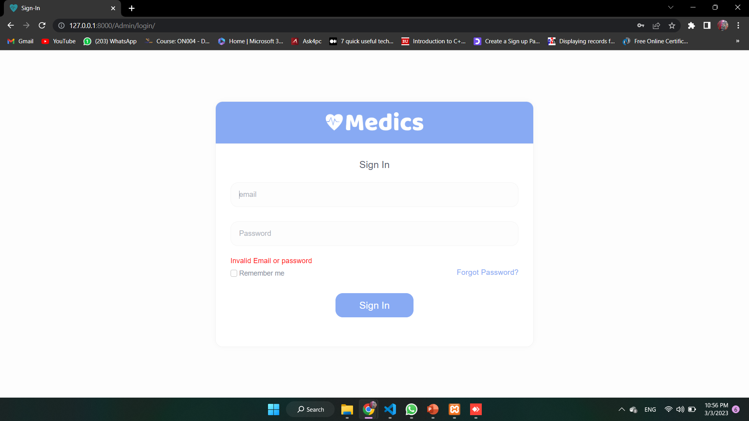
Admin Login Error

Slide 31
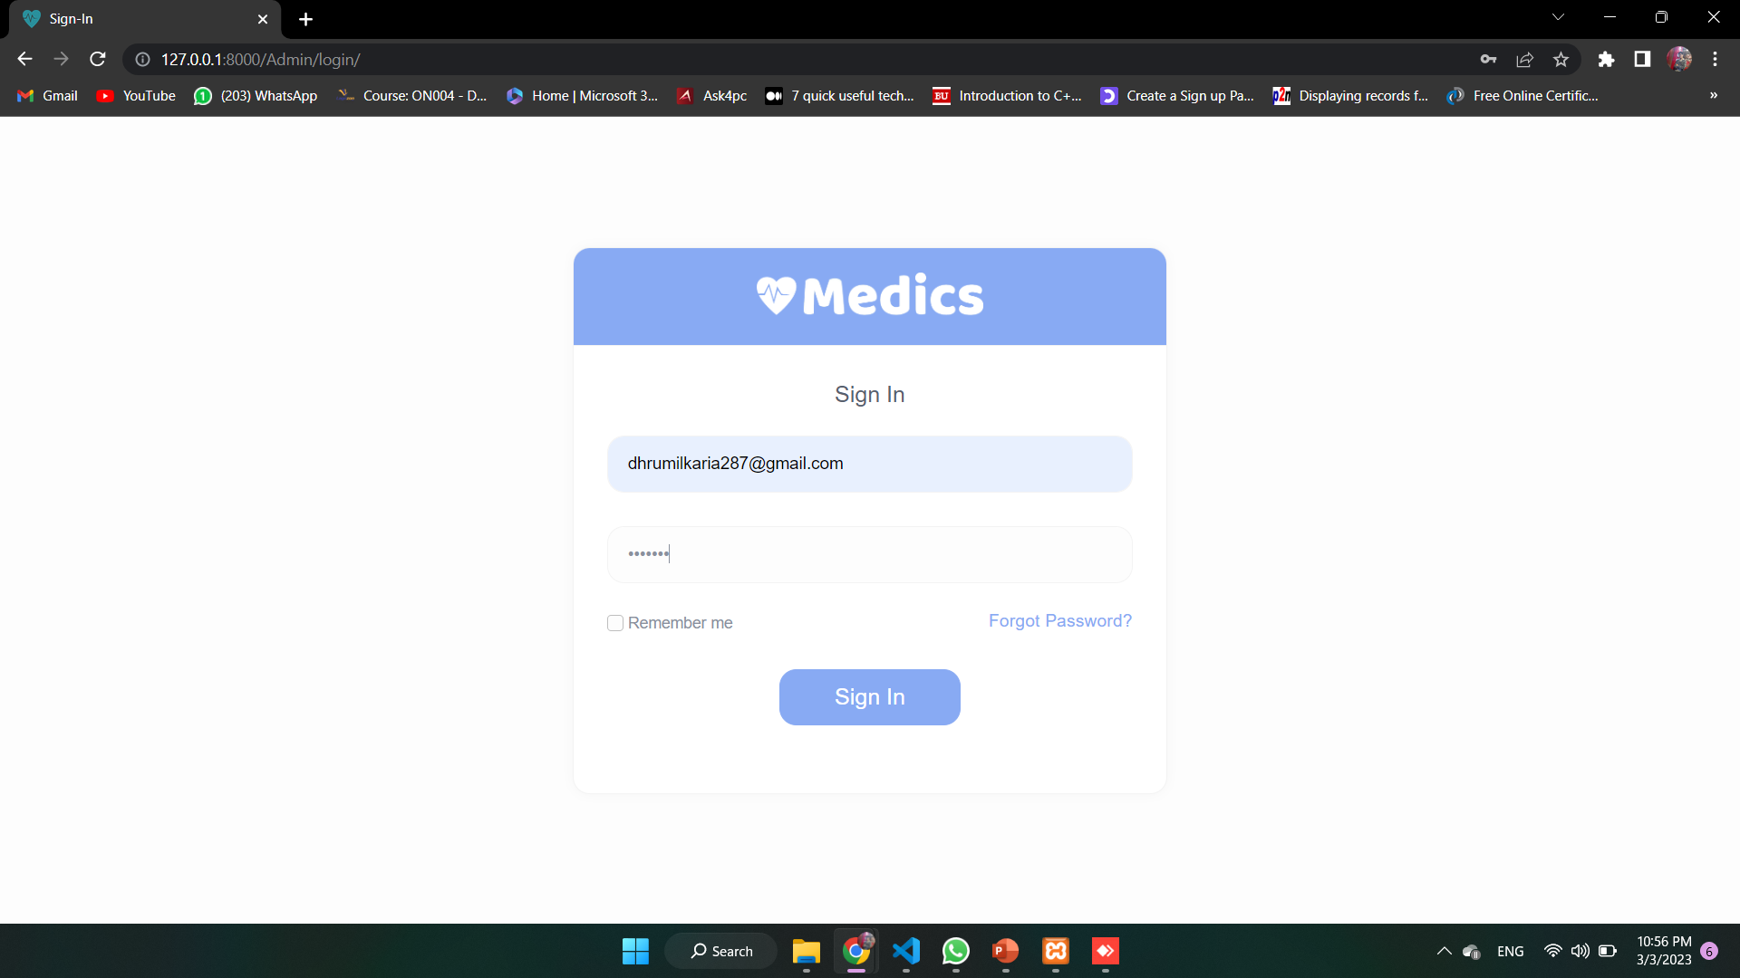
Admin Login Successfully

Slide 32
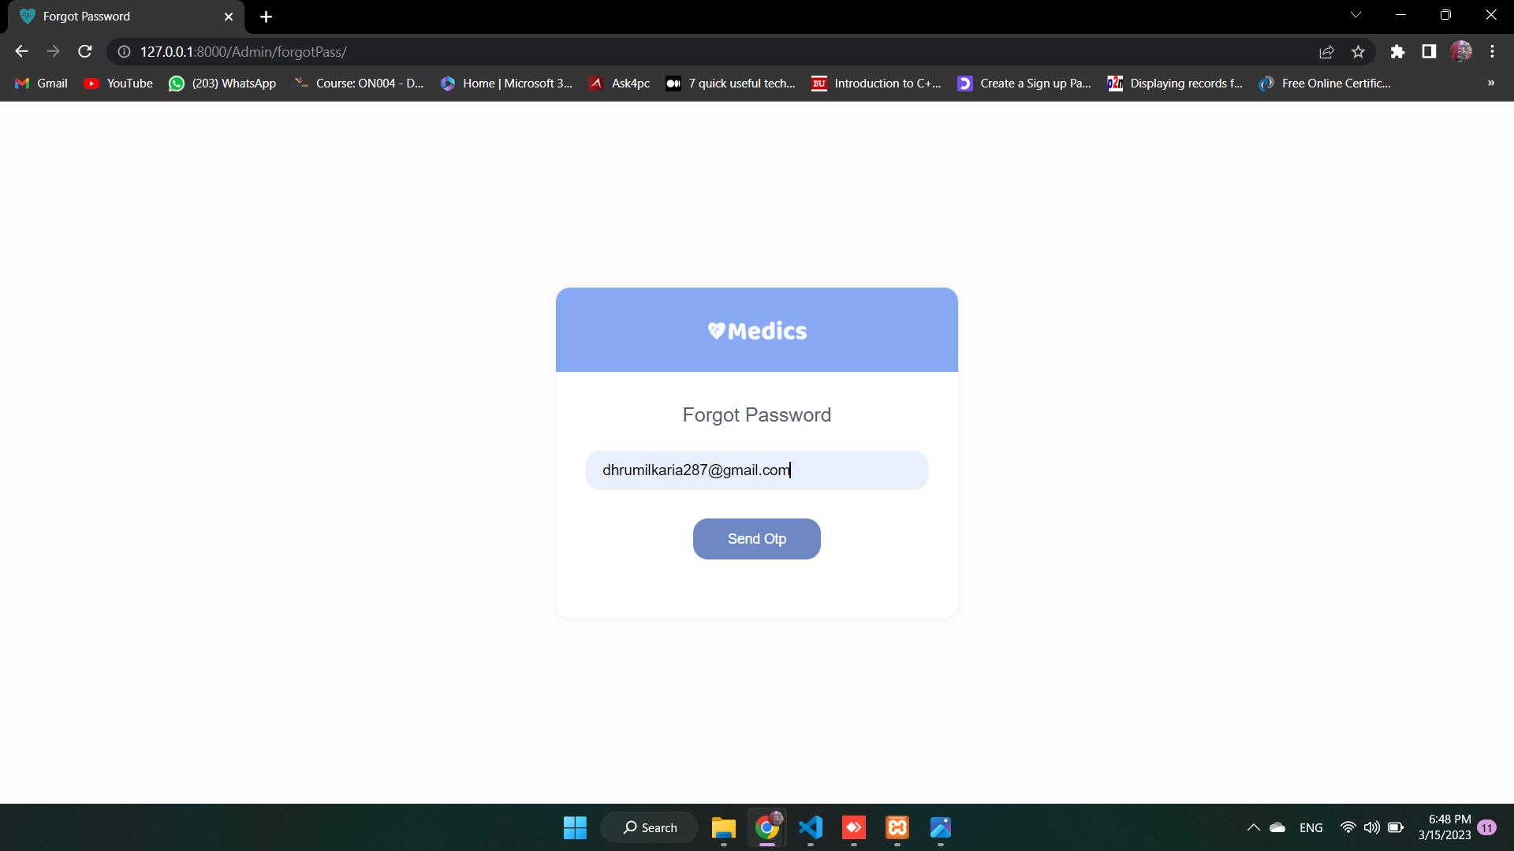
Admin Forgot Password

Slide 33
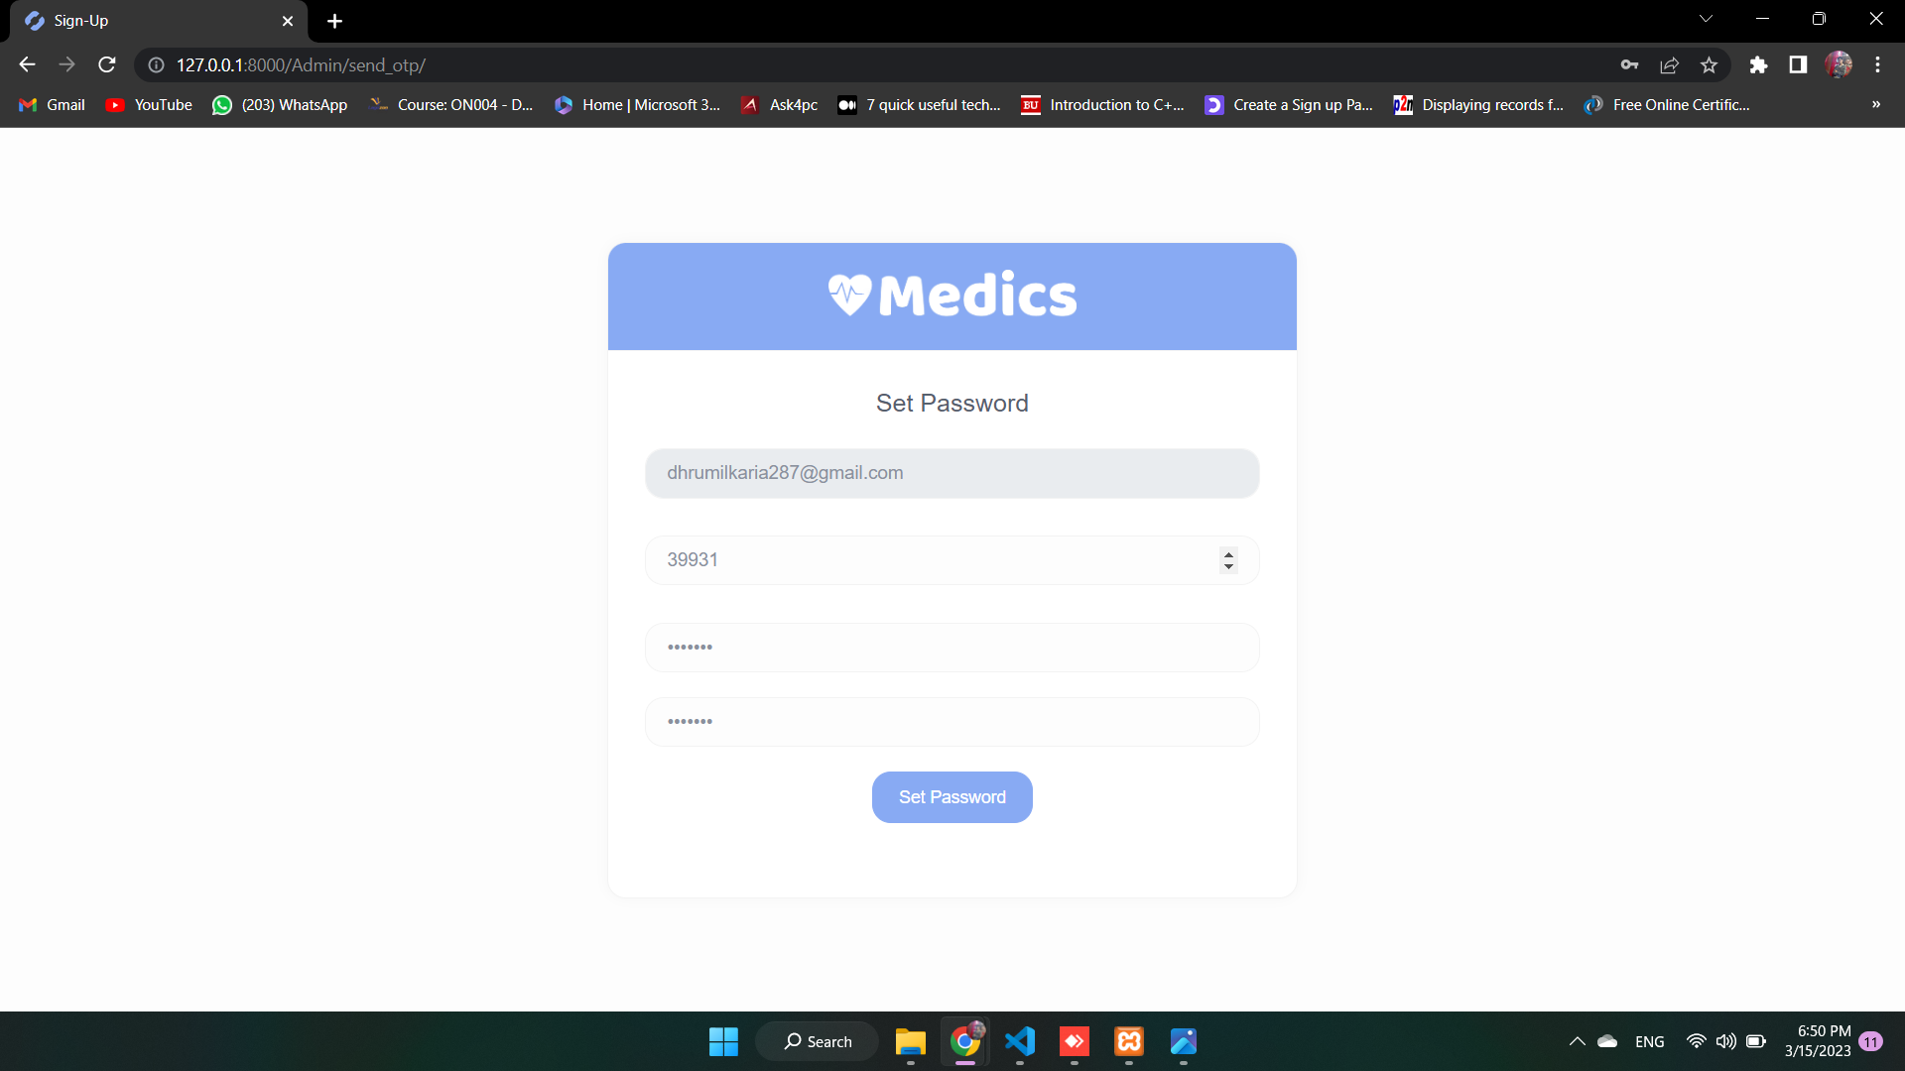
Admin Send OTP & New Password

Slide 34
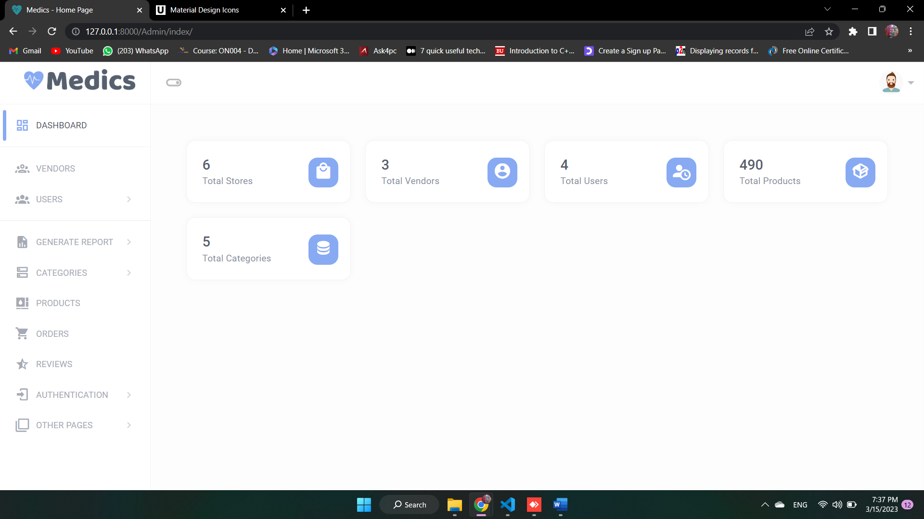
Dashboard of Admin

Slide 35
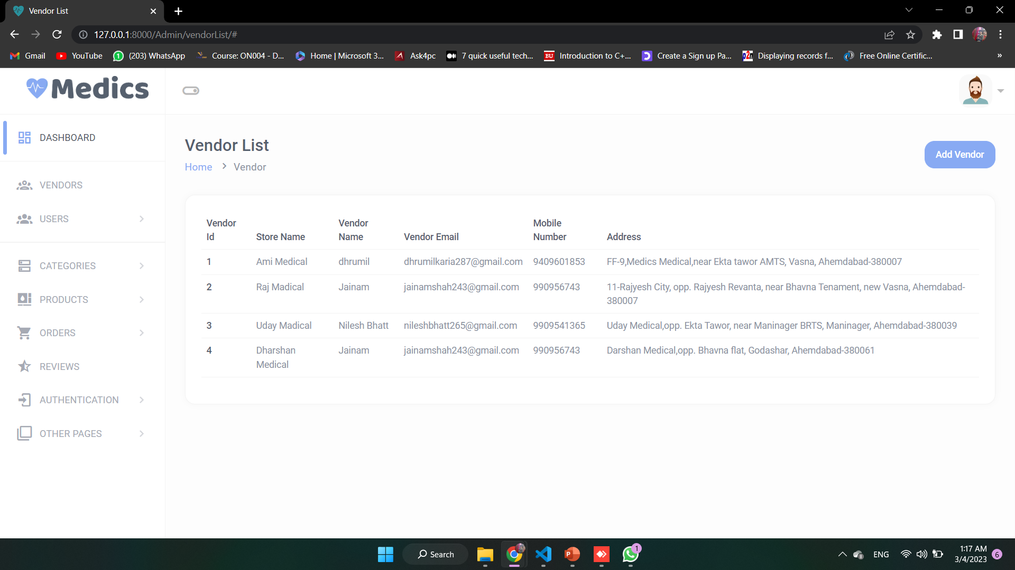
Vendors

Slide 36
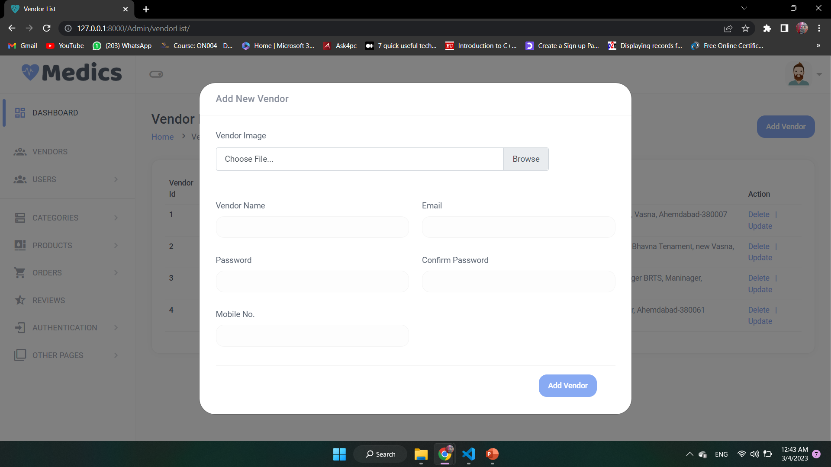
Add Vendor

Slide 37
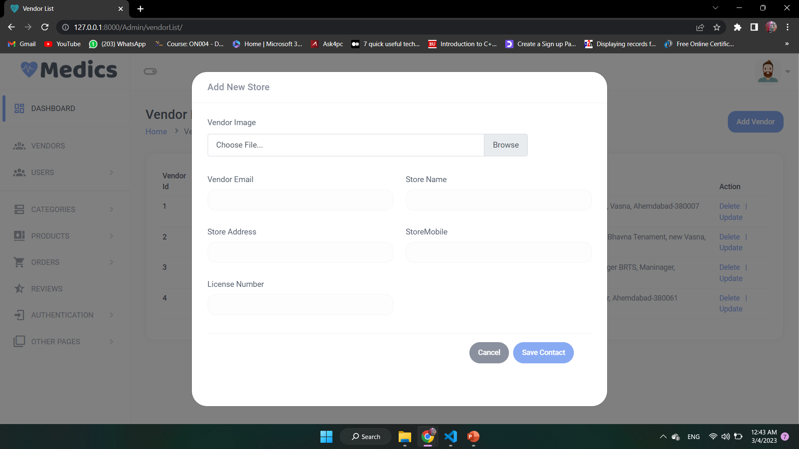
Add Store

Slide 38
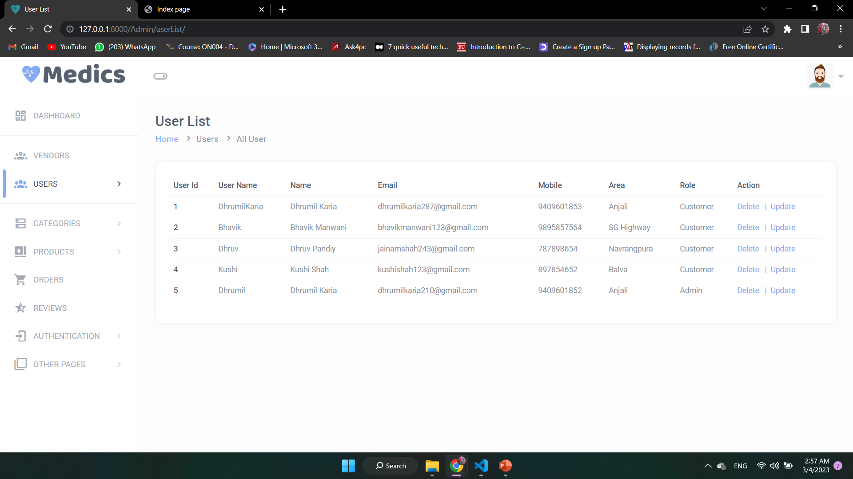
Users

Slide 39
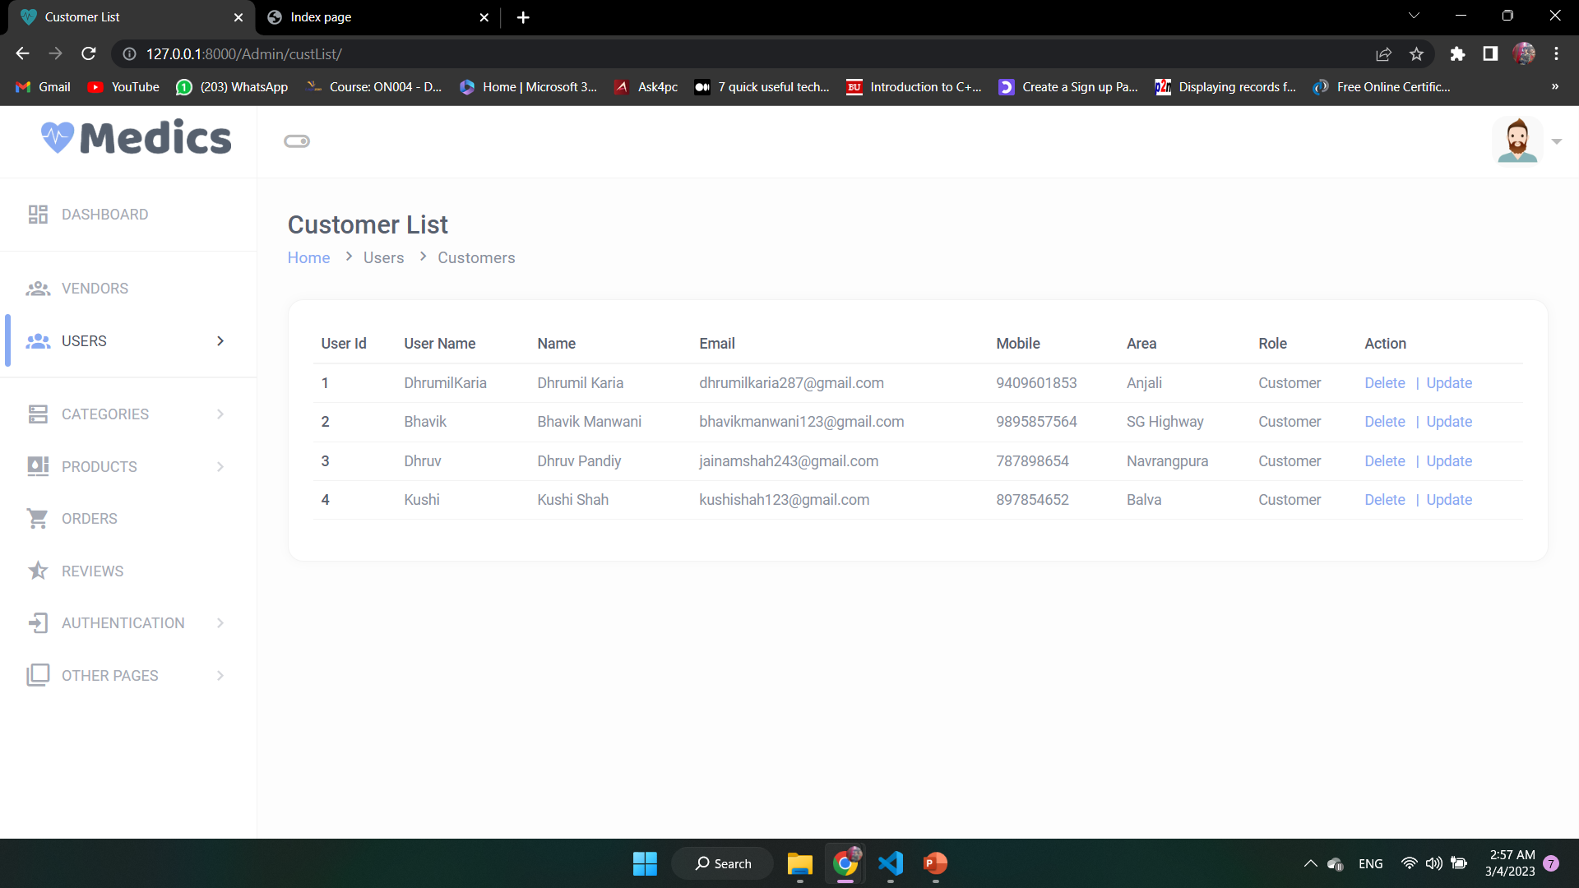
Customers

Slide 40
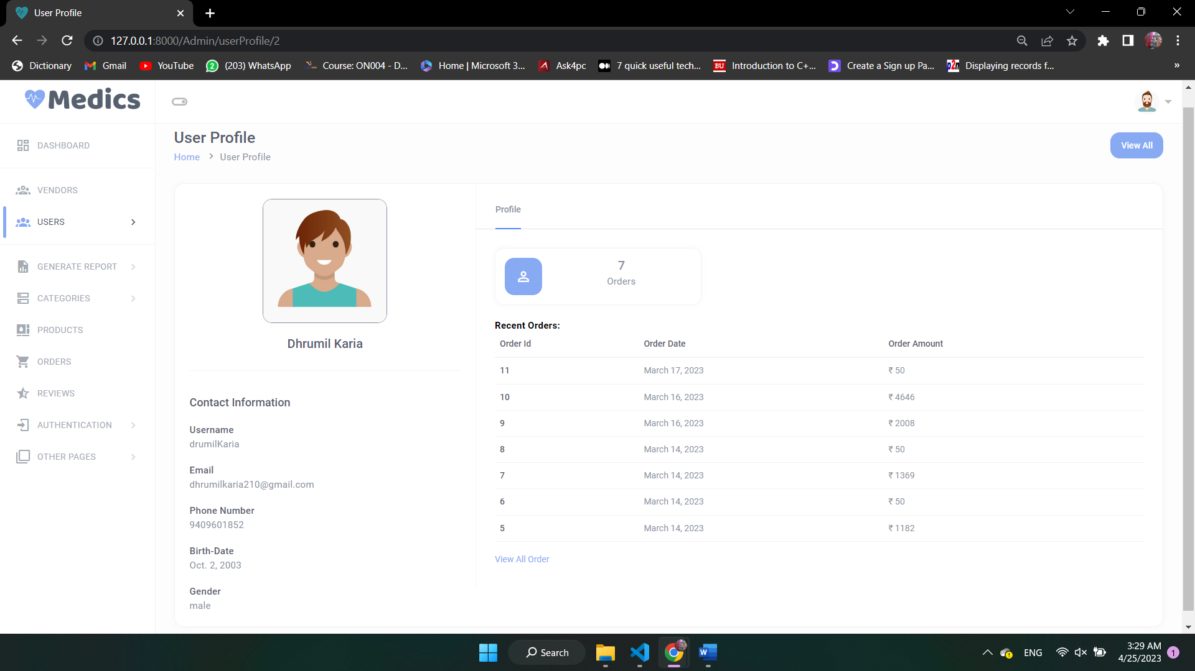
User Details

Slide 41
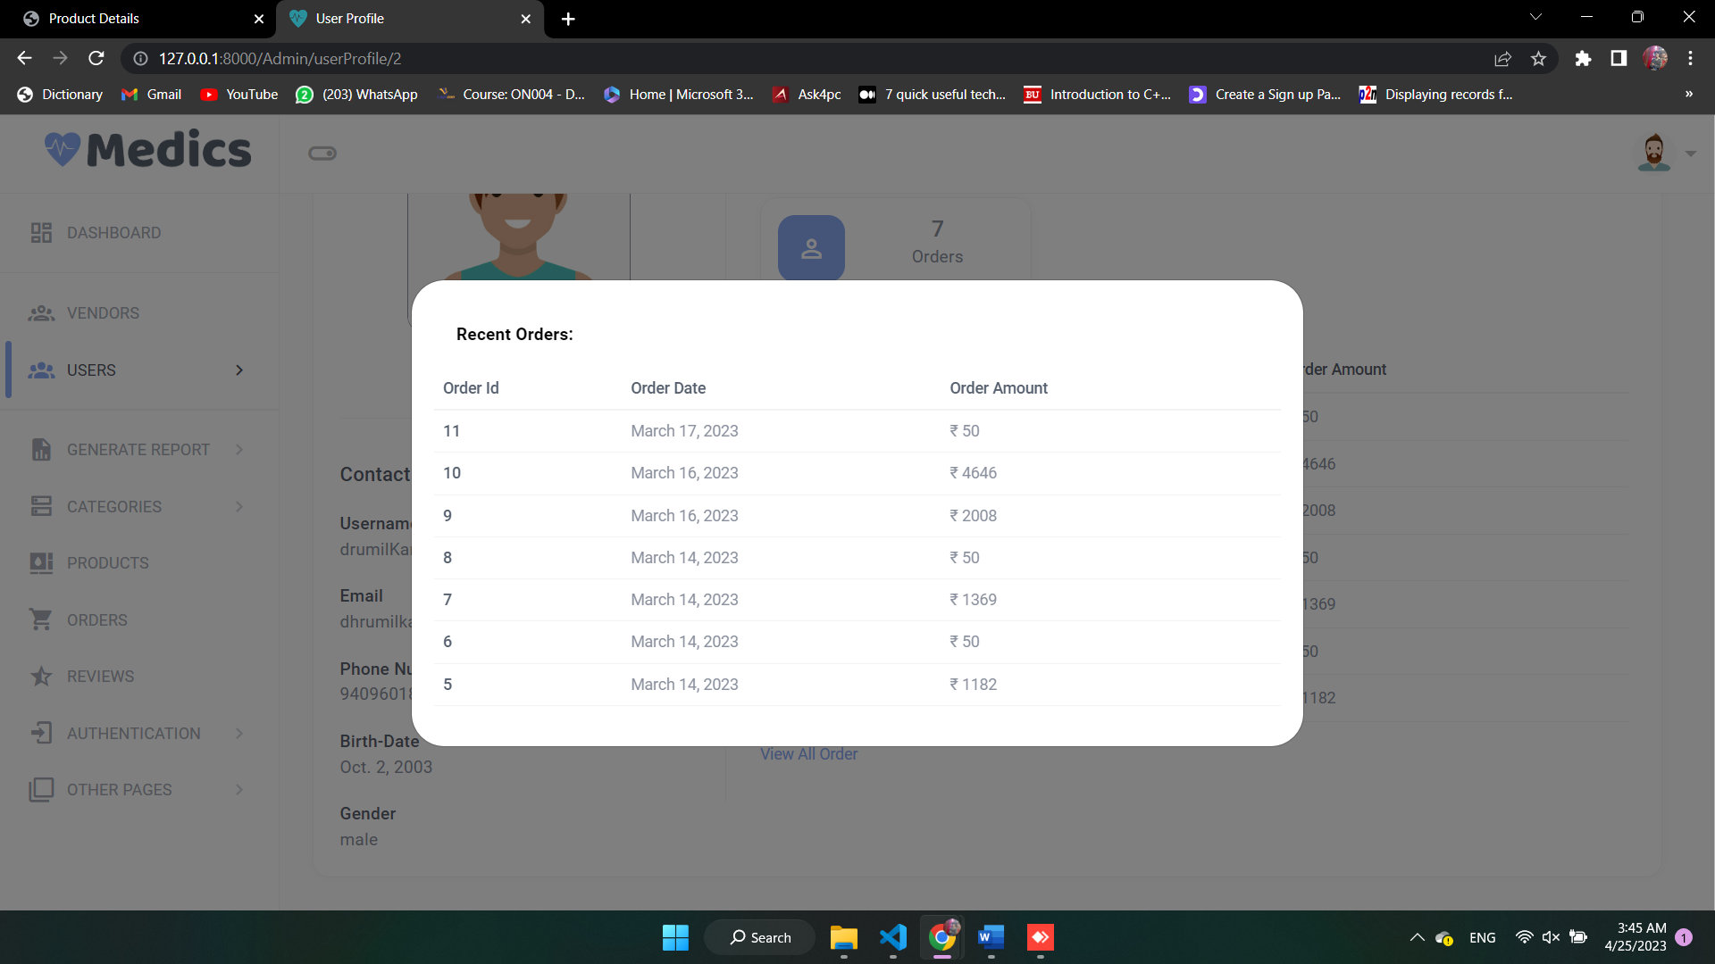
Admin User’s all products

Slide 42
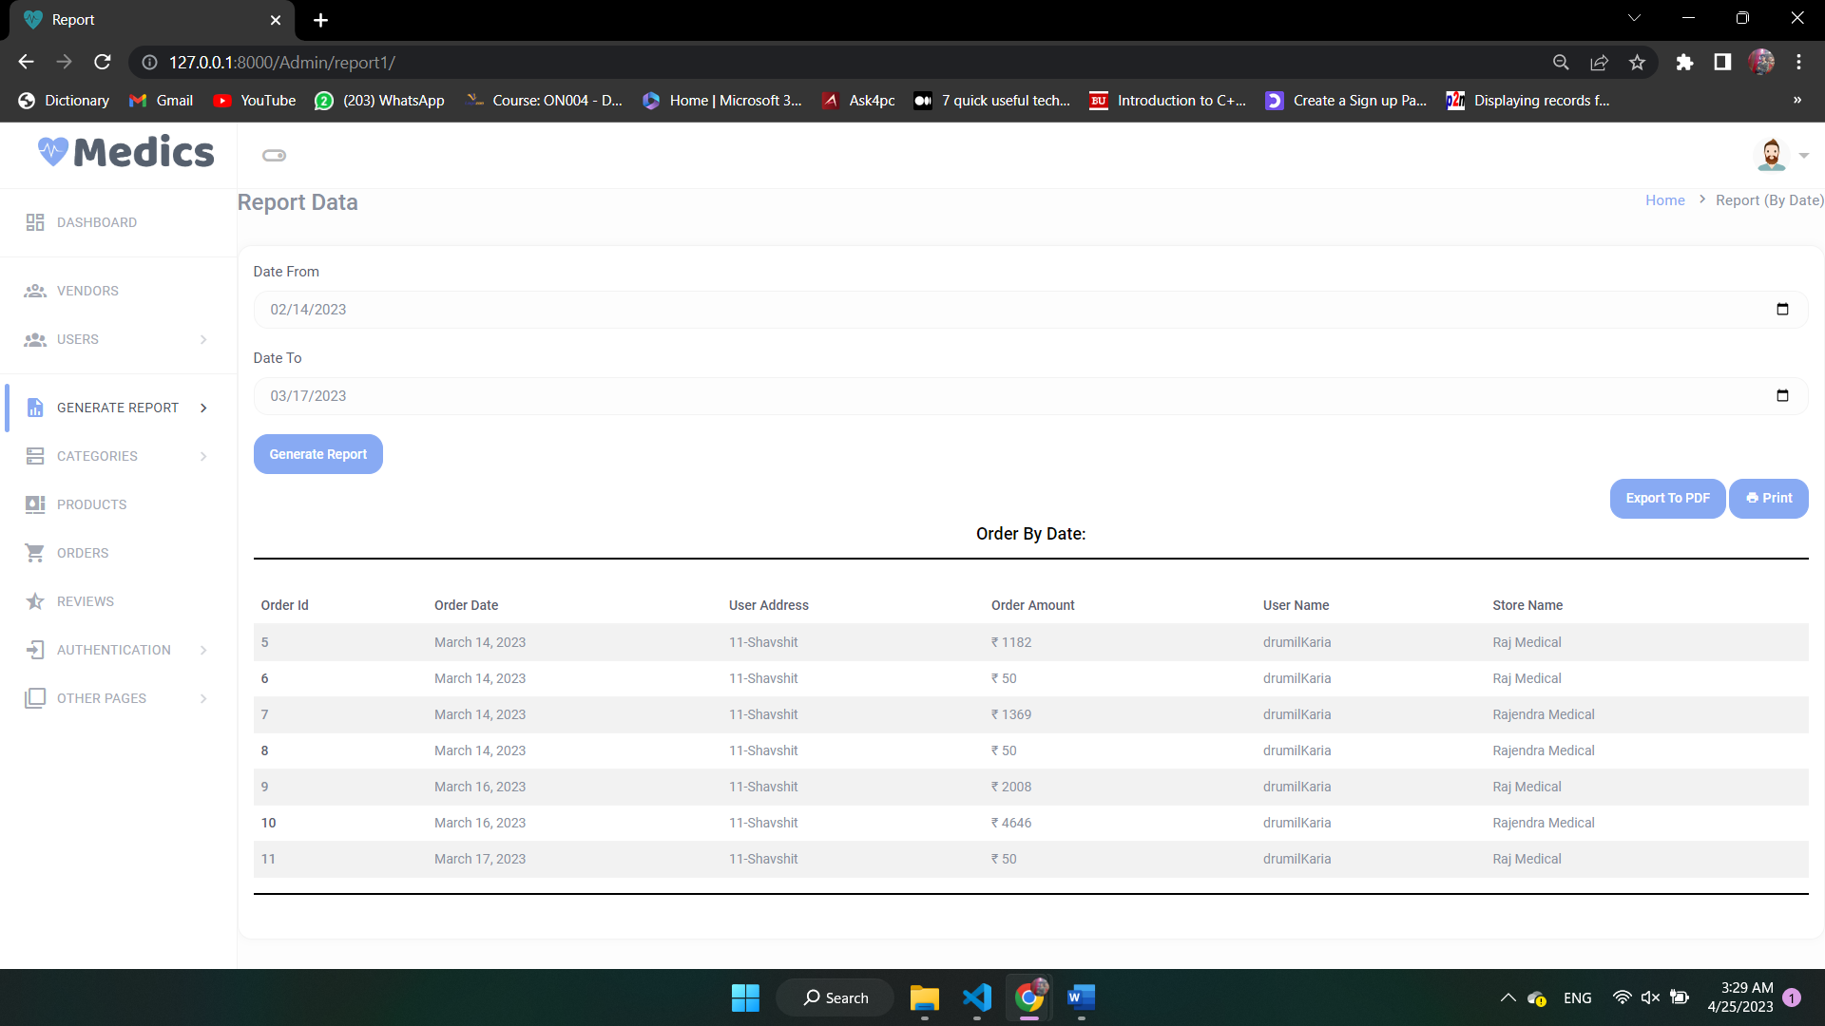
Report By Date

Slide 43
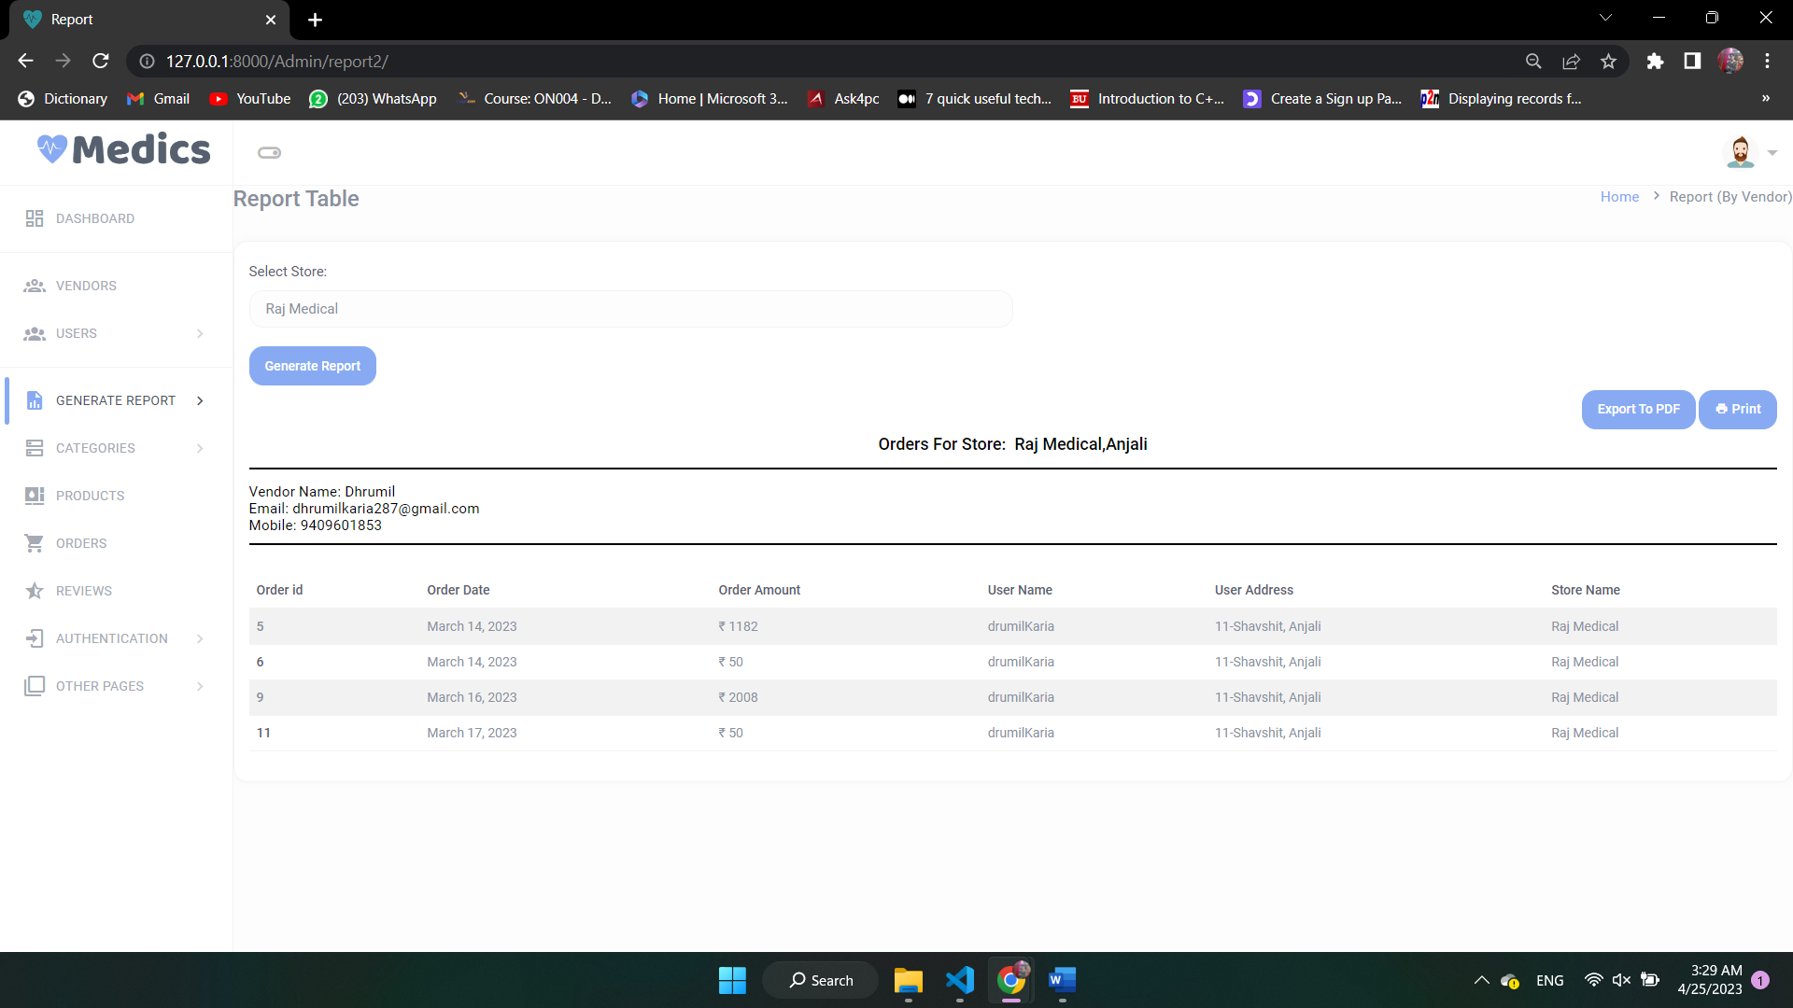
Report By Vendor

Slide 44
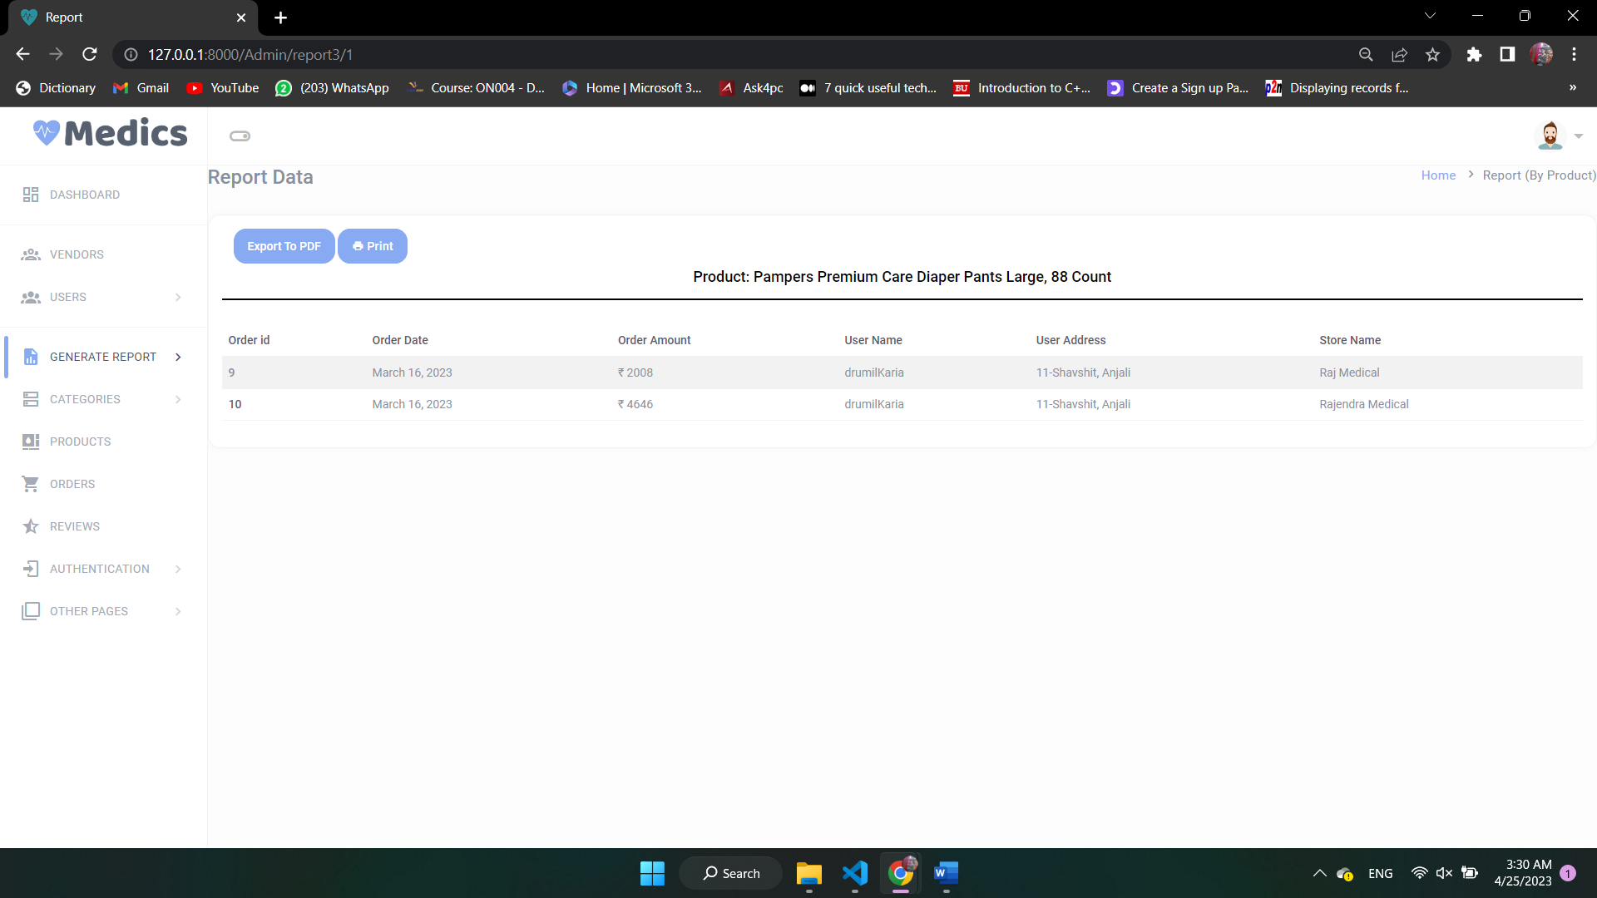
Report By Product

Slide 45
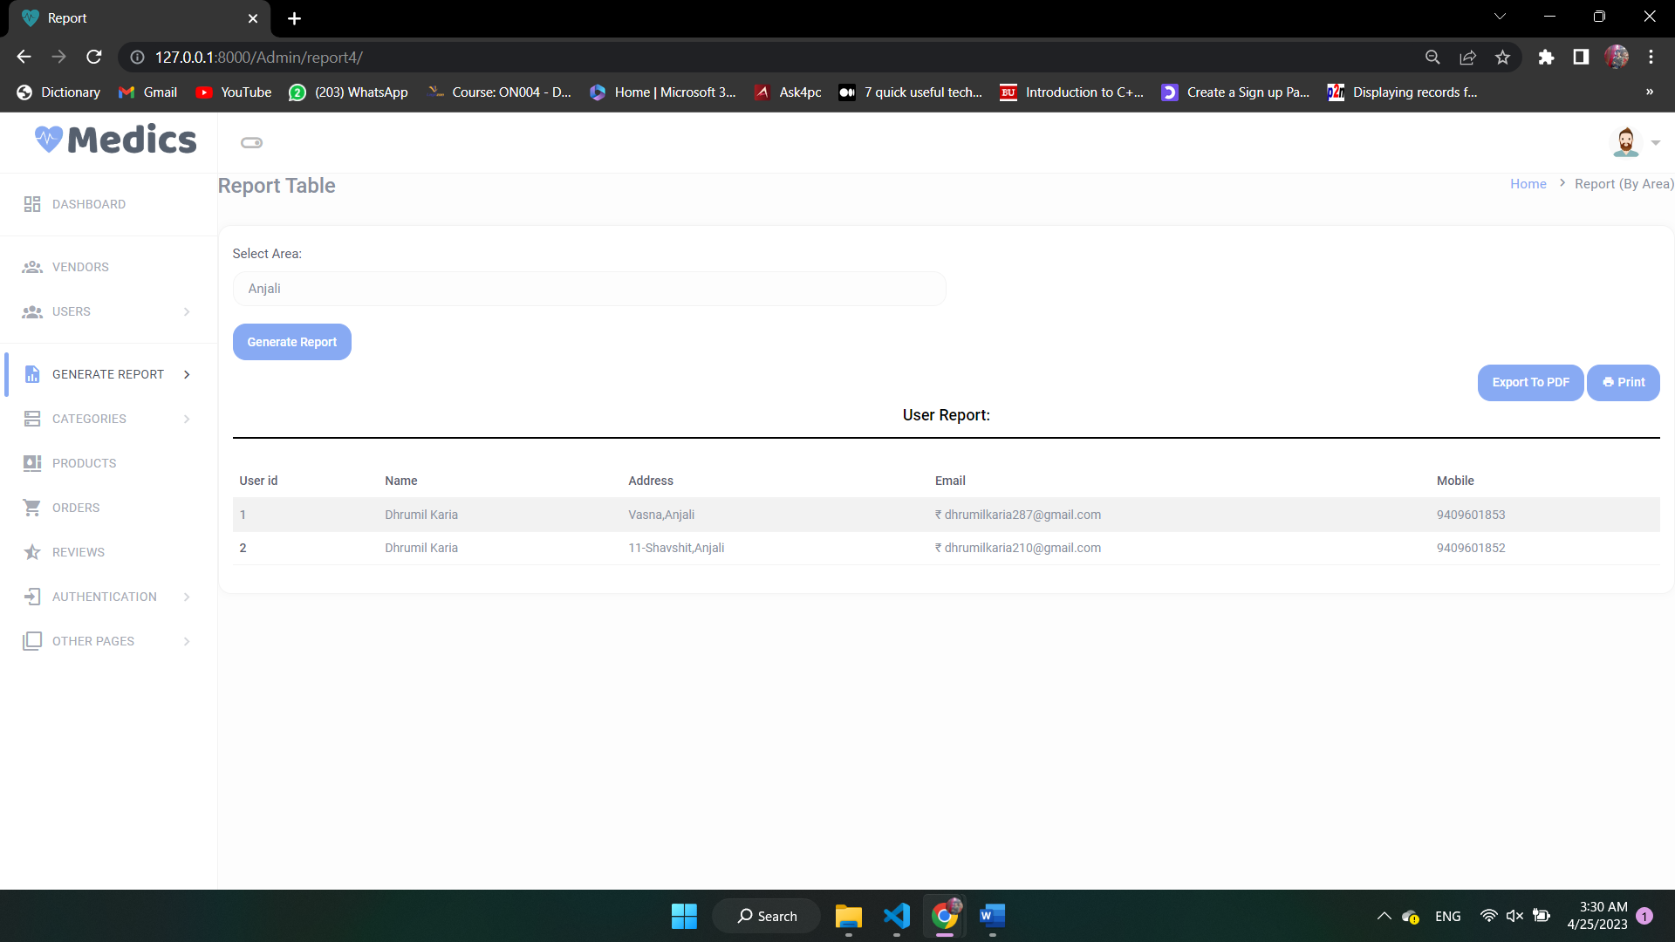
Report By Area

Slide 46
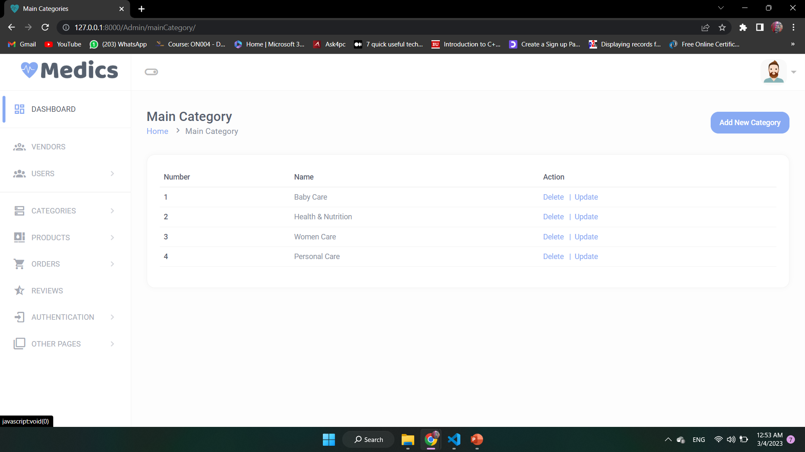
Categorys

Slide 47
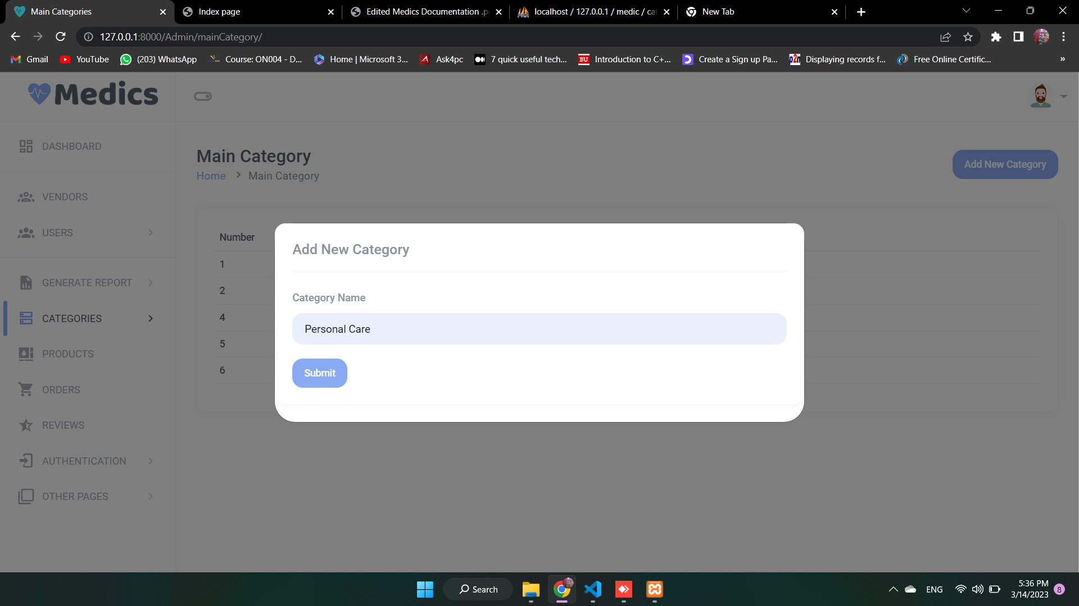
Add Category

Slide 48
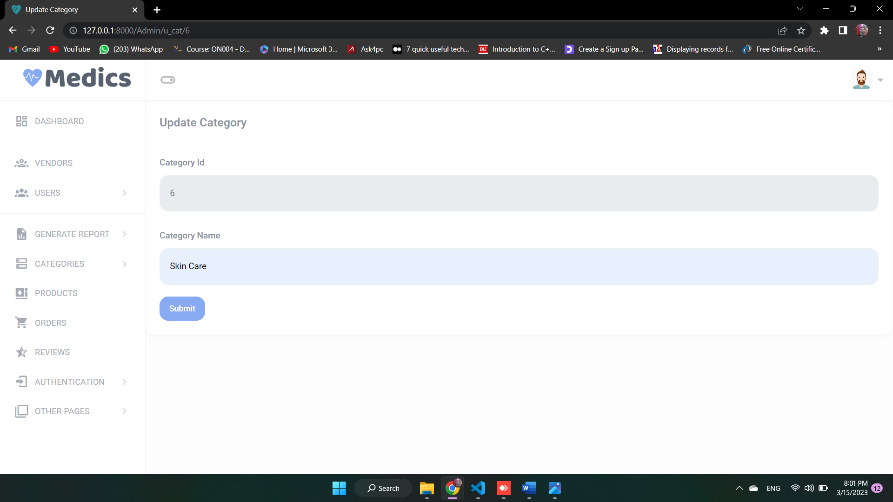
Update Category

Slide 49
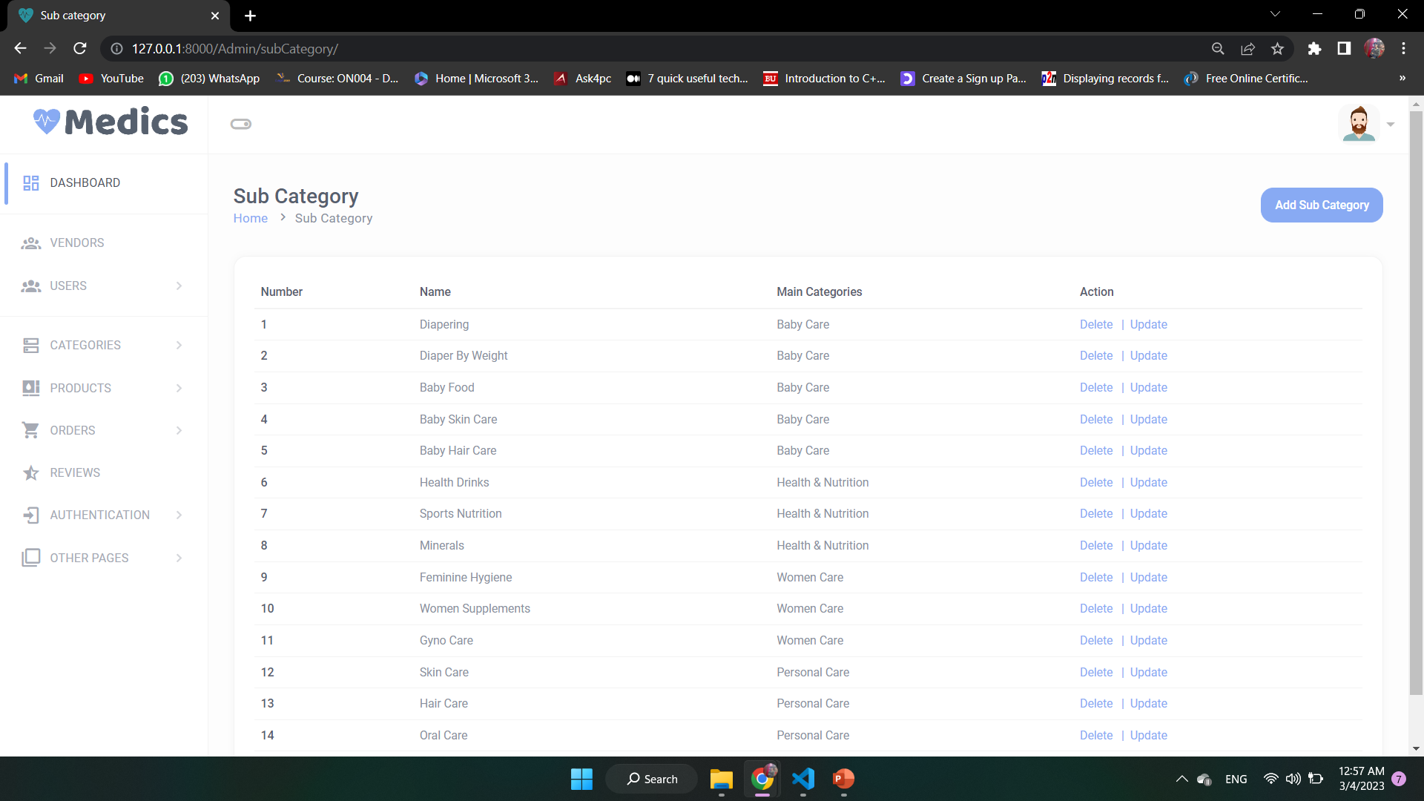
Sub Categorys

Slide 50
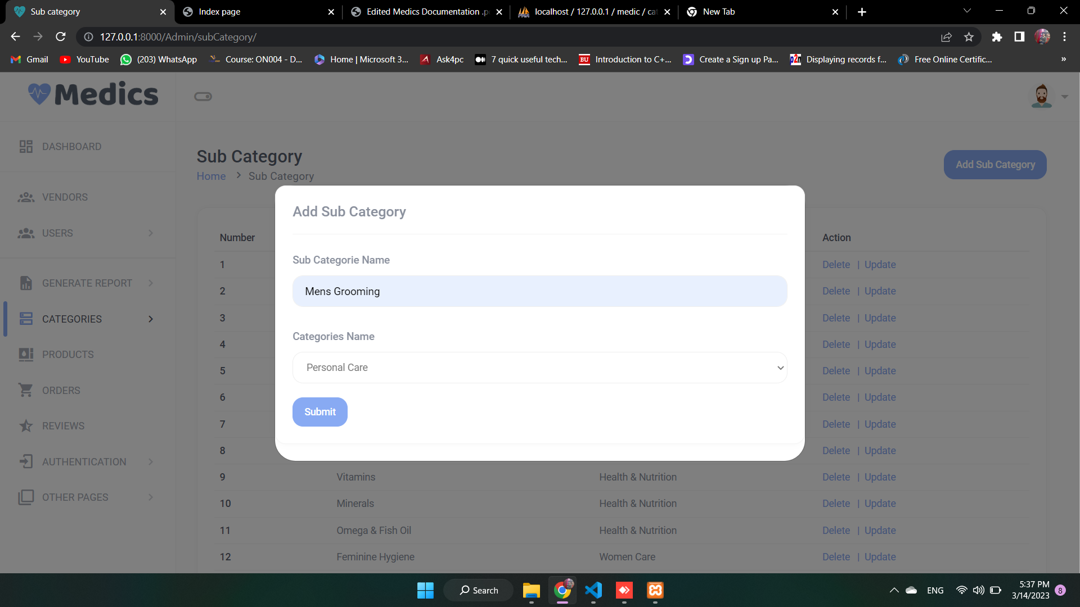
Add Sub Category

Slide 51
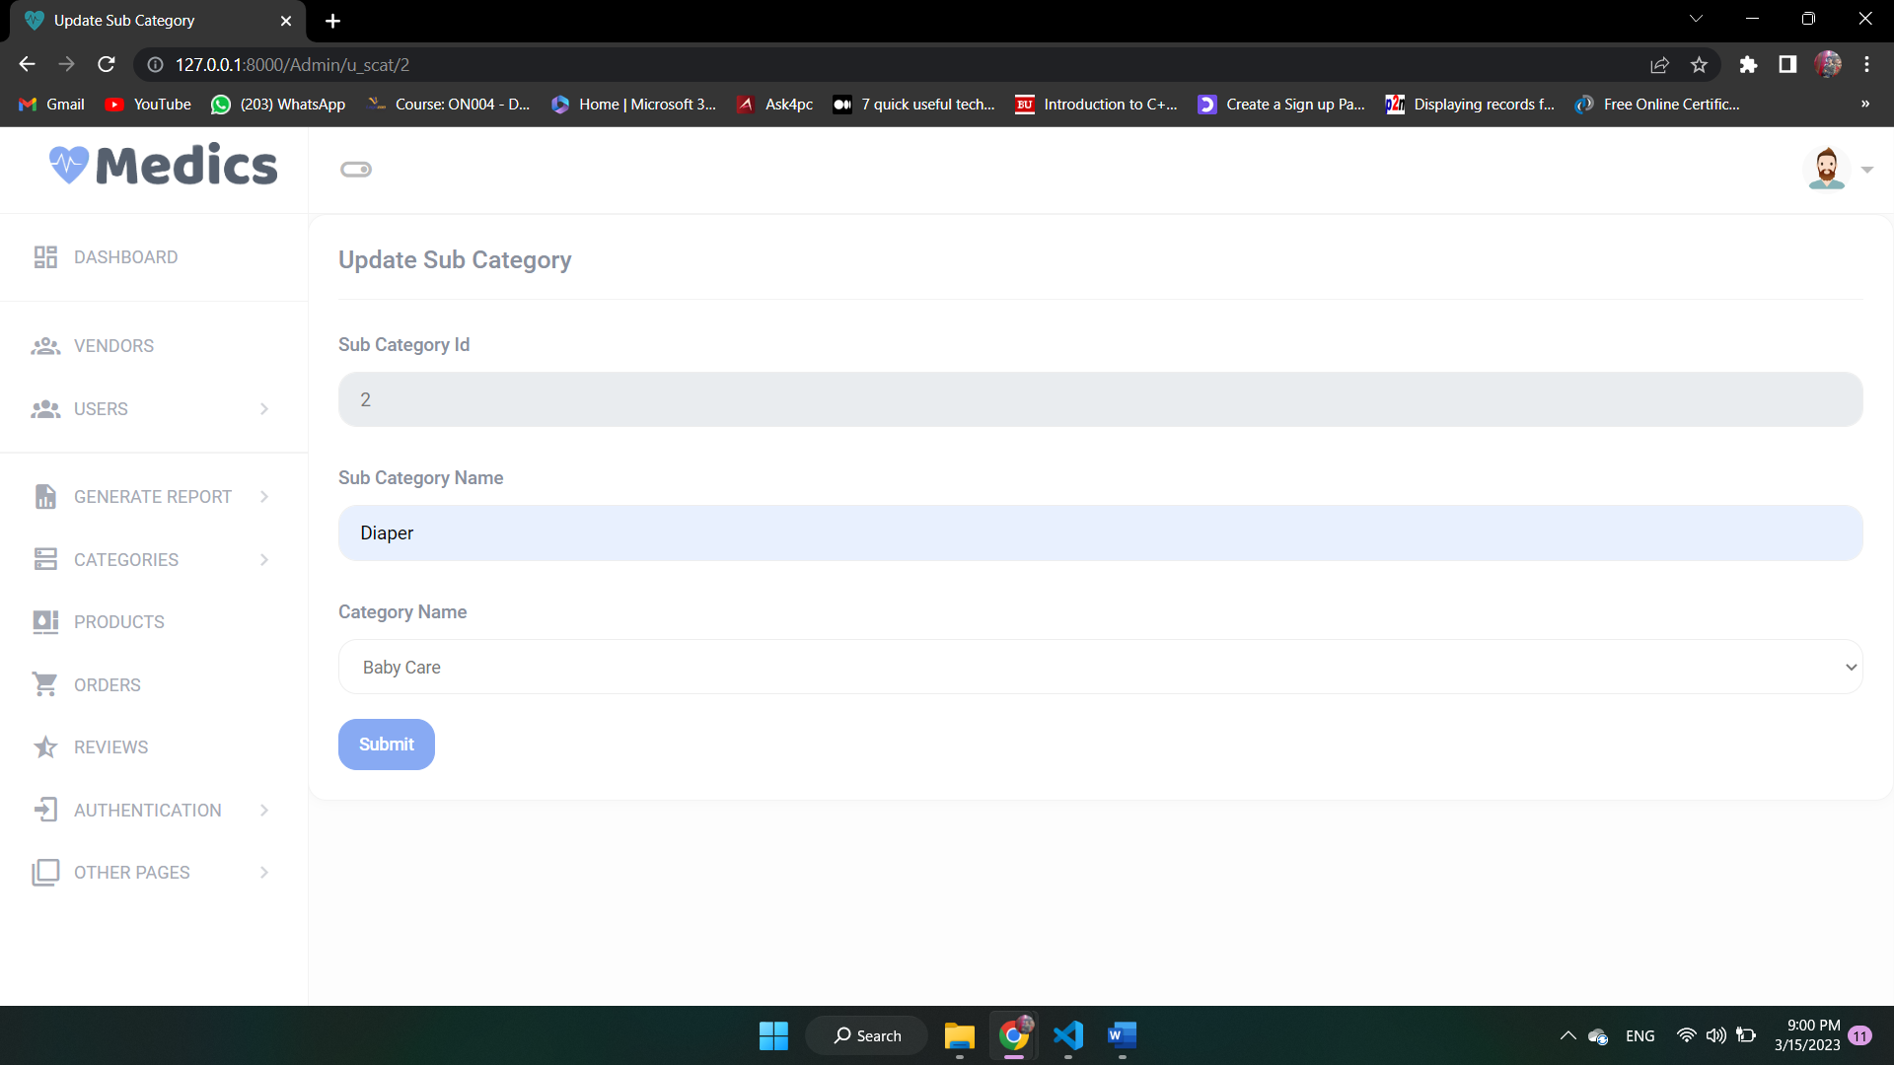
Update Sub Category

Slide 52
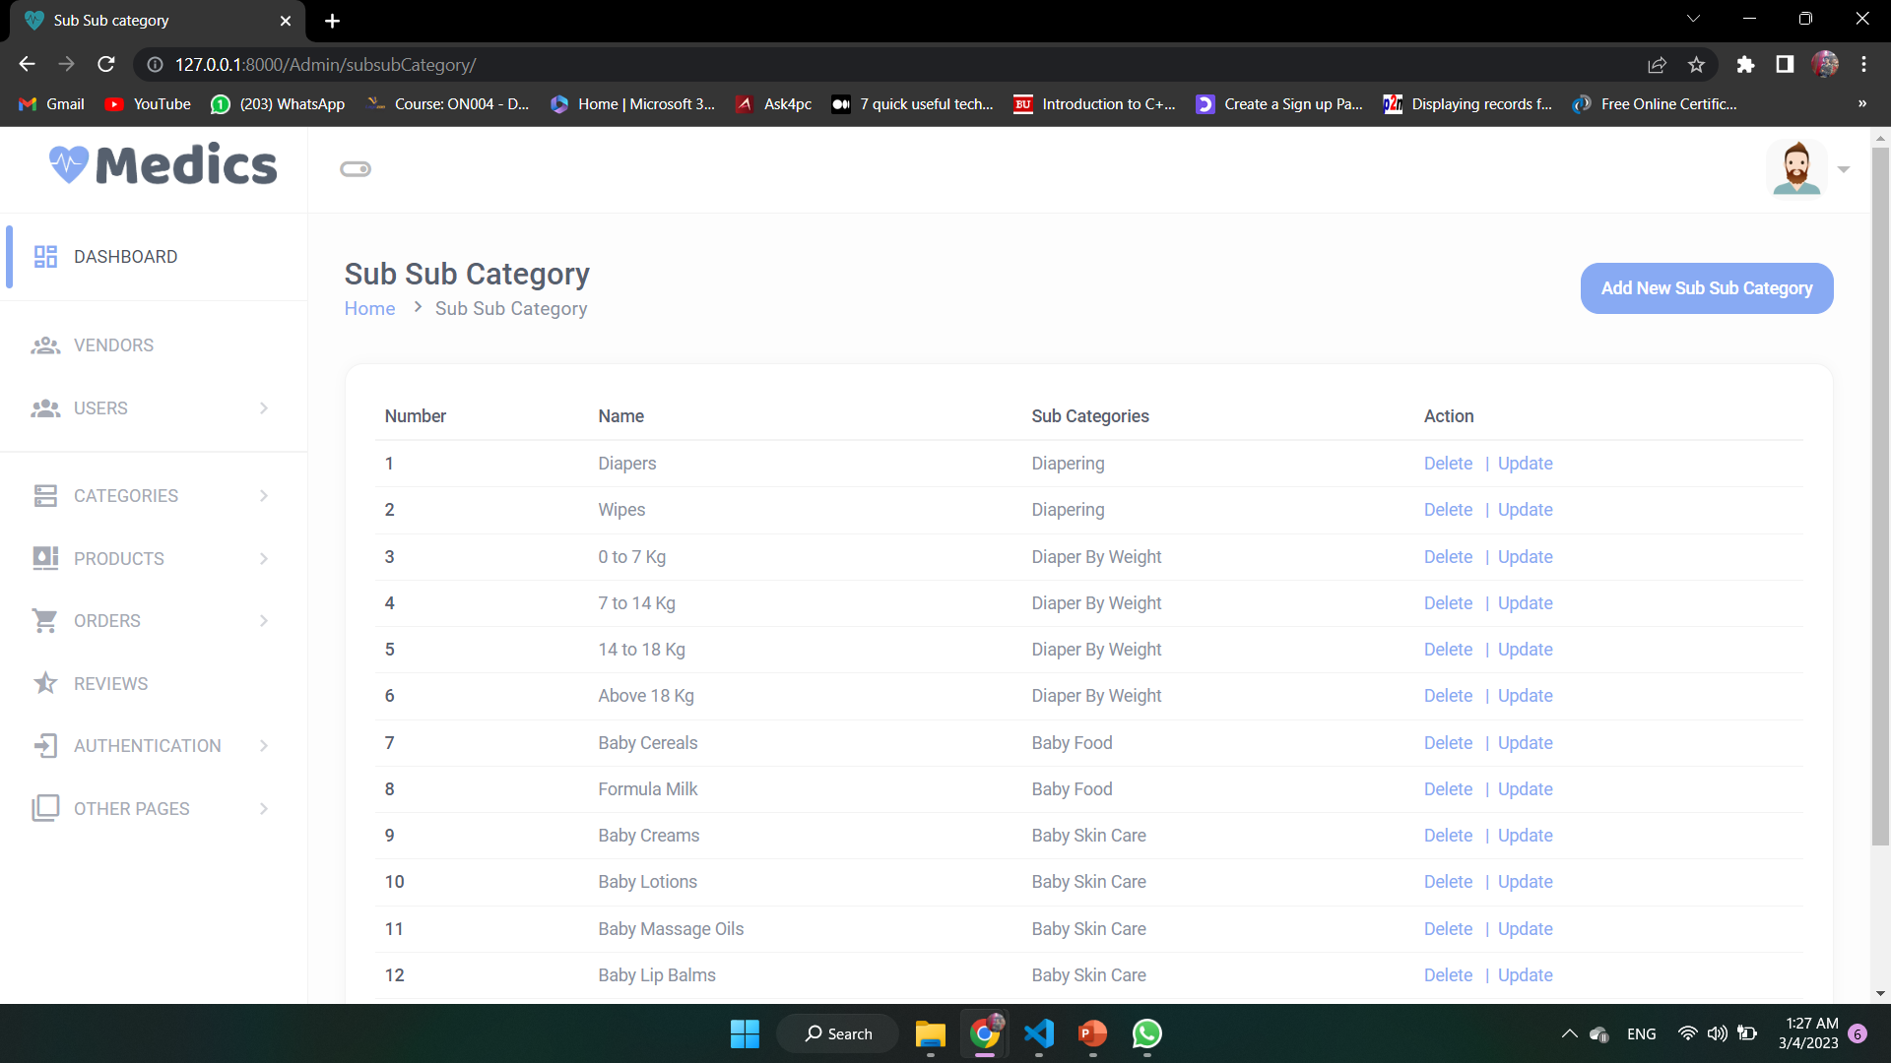
Sub Sub Categorys

Slide 53
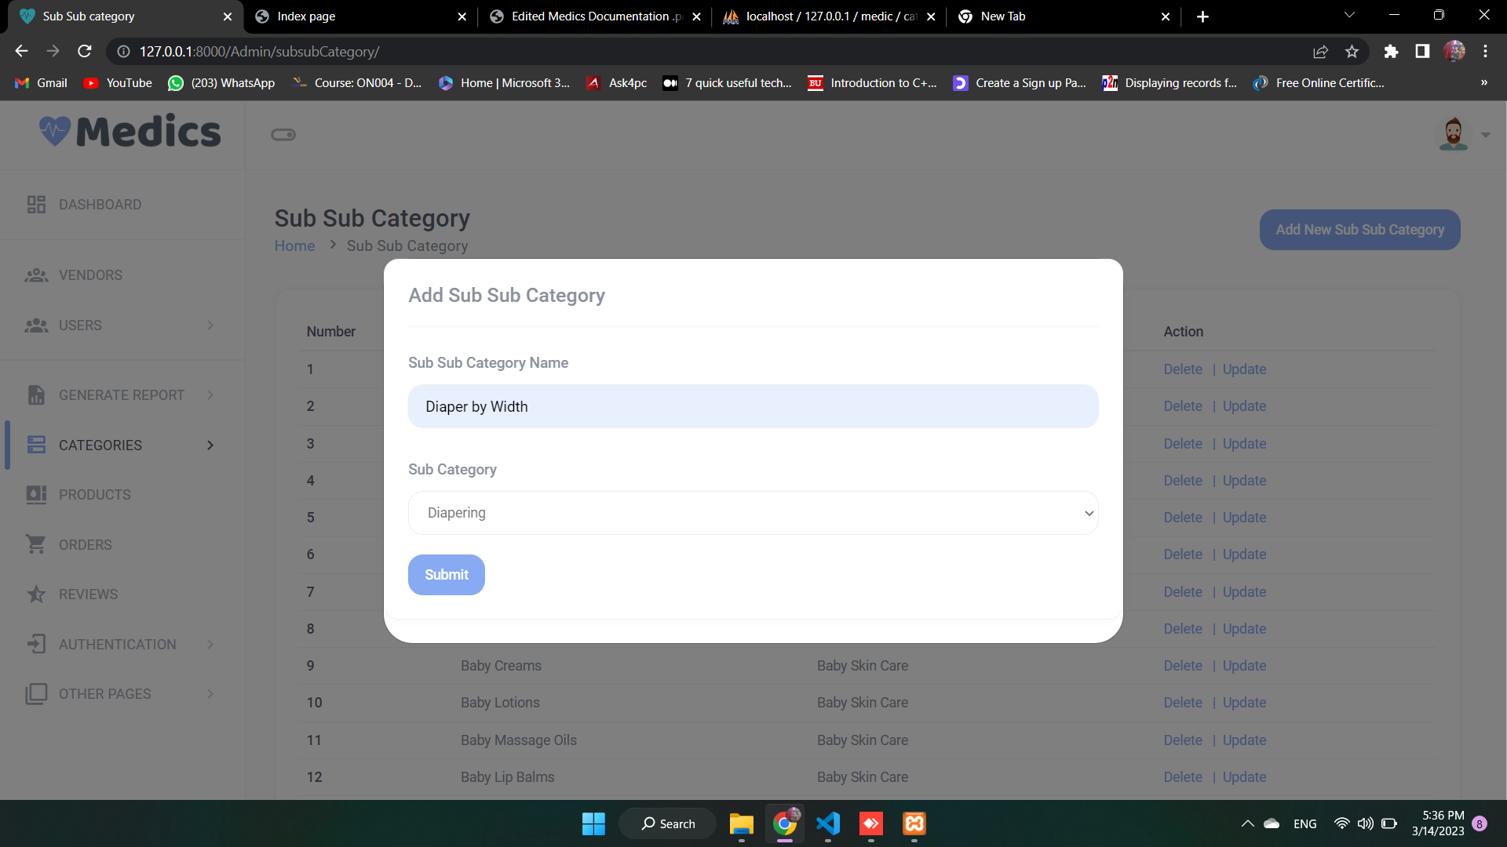
Add Sub Sub Category

Slide 54
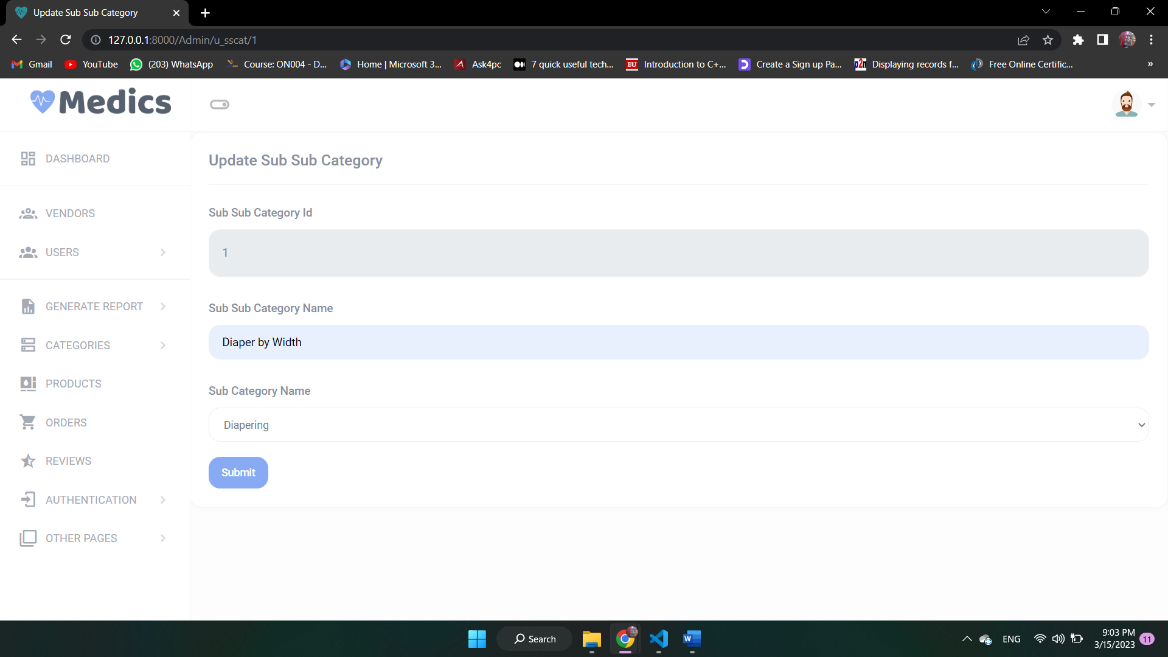
Update Sub Sub Category

Slide 55
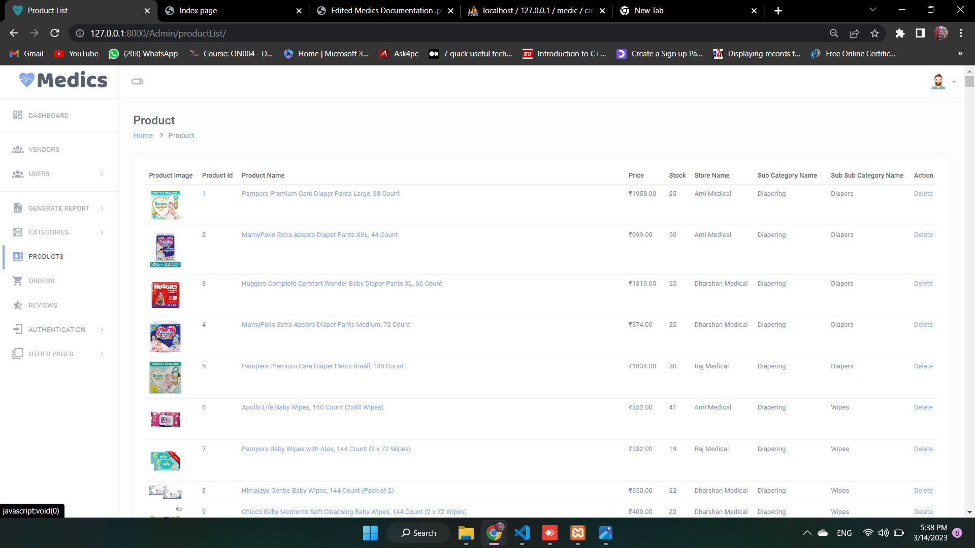
Products

Slide 56
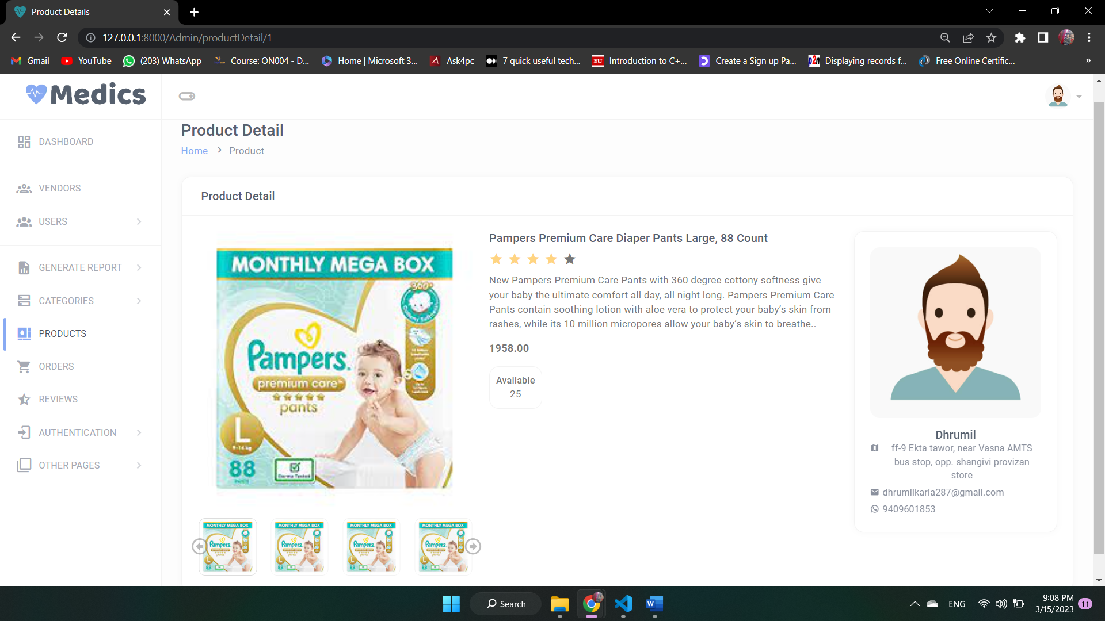
Product Detail

Slide 57
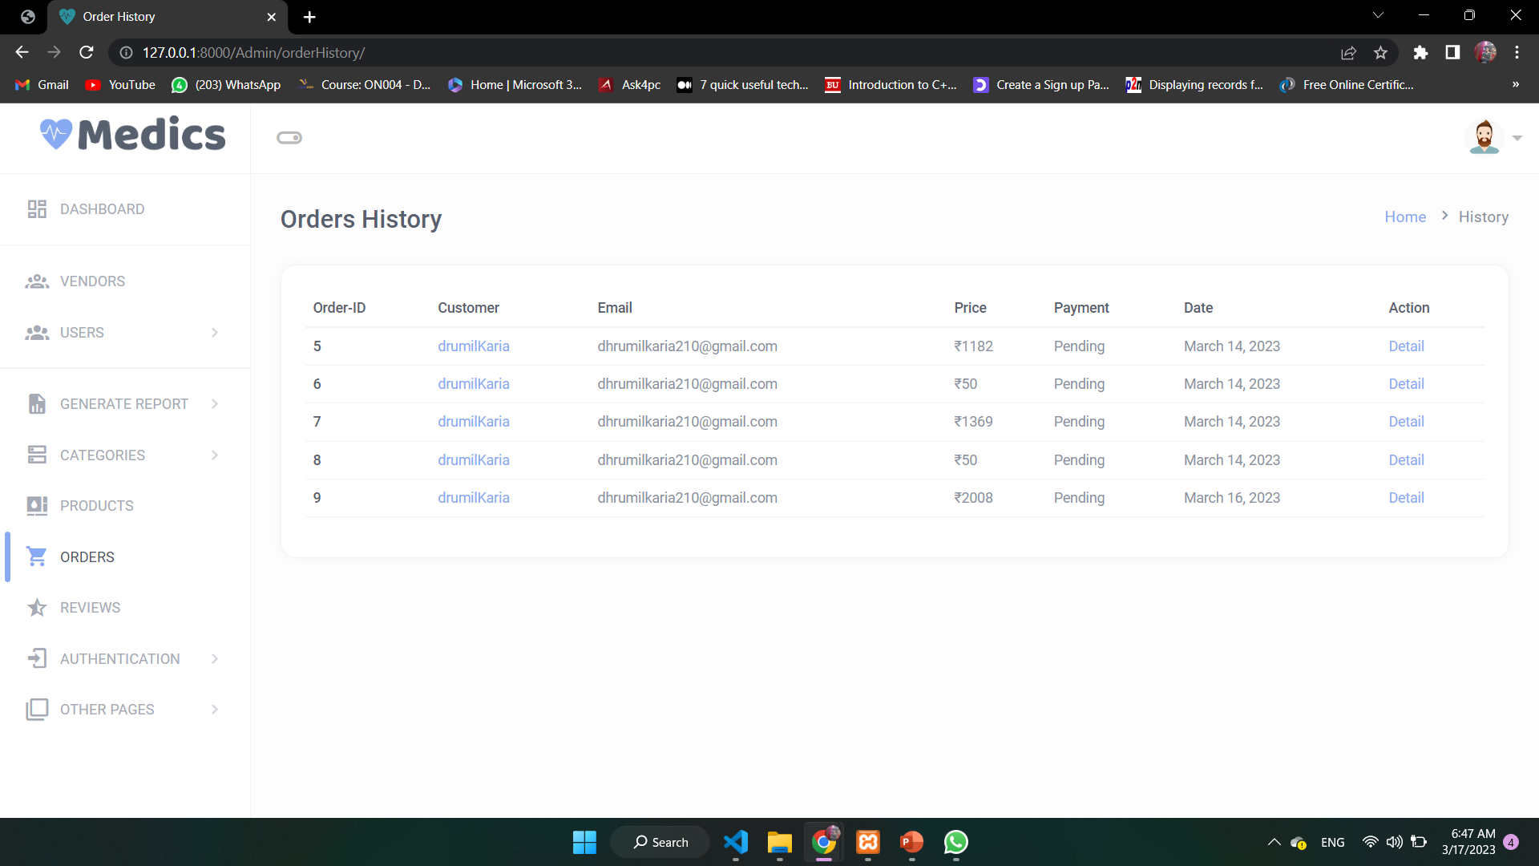
Orders

Slide 58
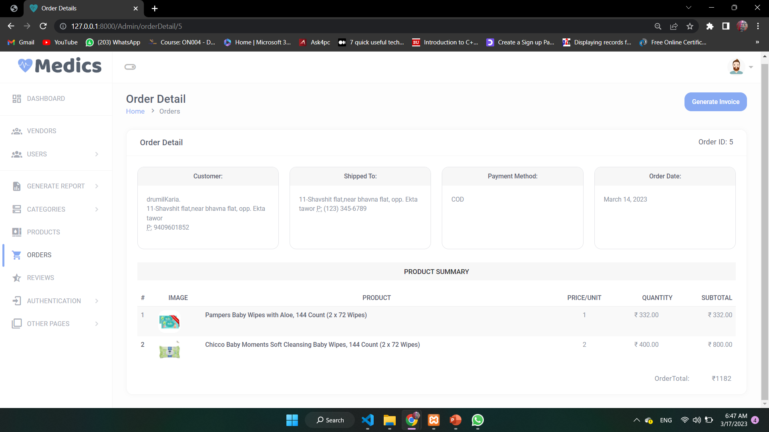
Order Detail

Slide 59
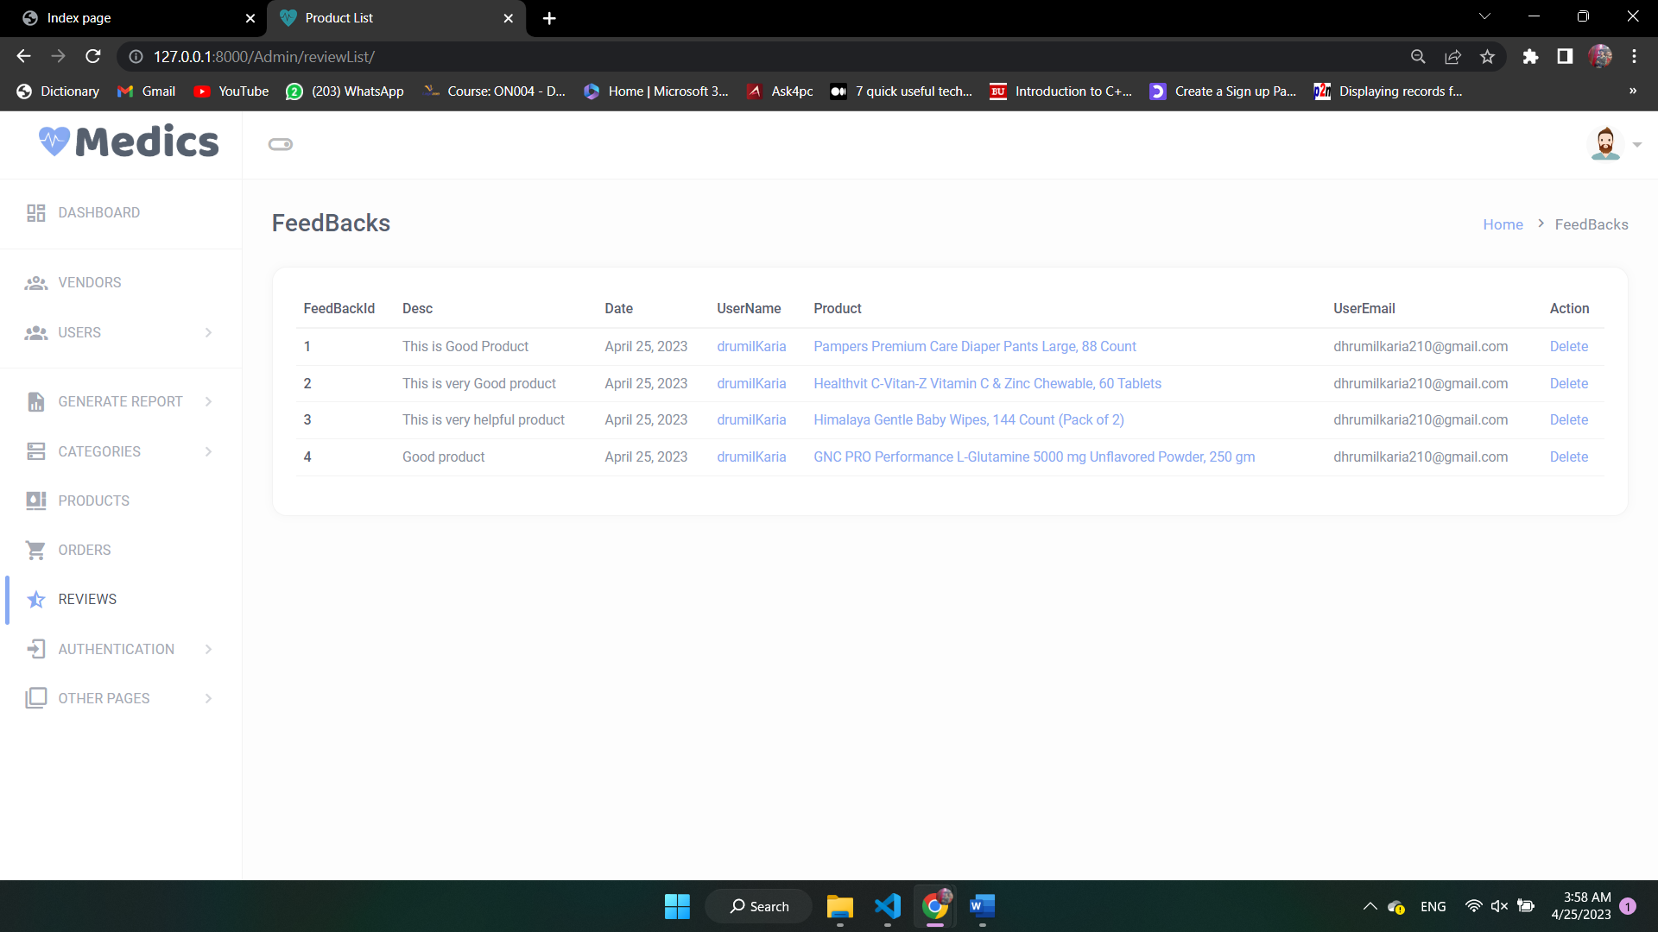
Feedbacks

Slide 60
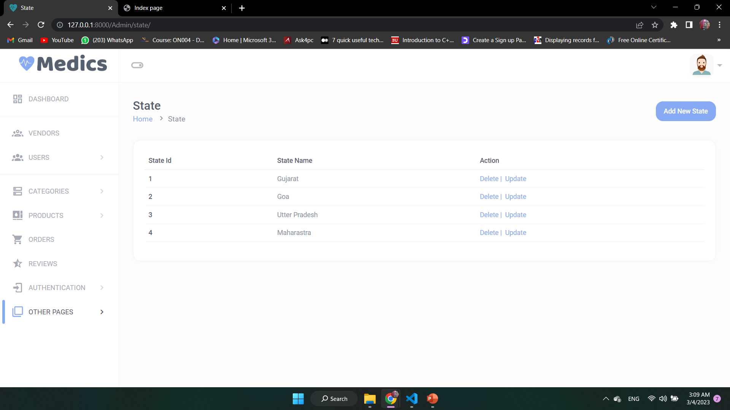
States

Slide 61
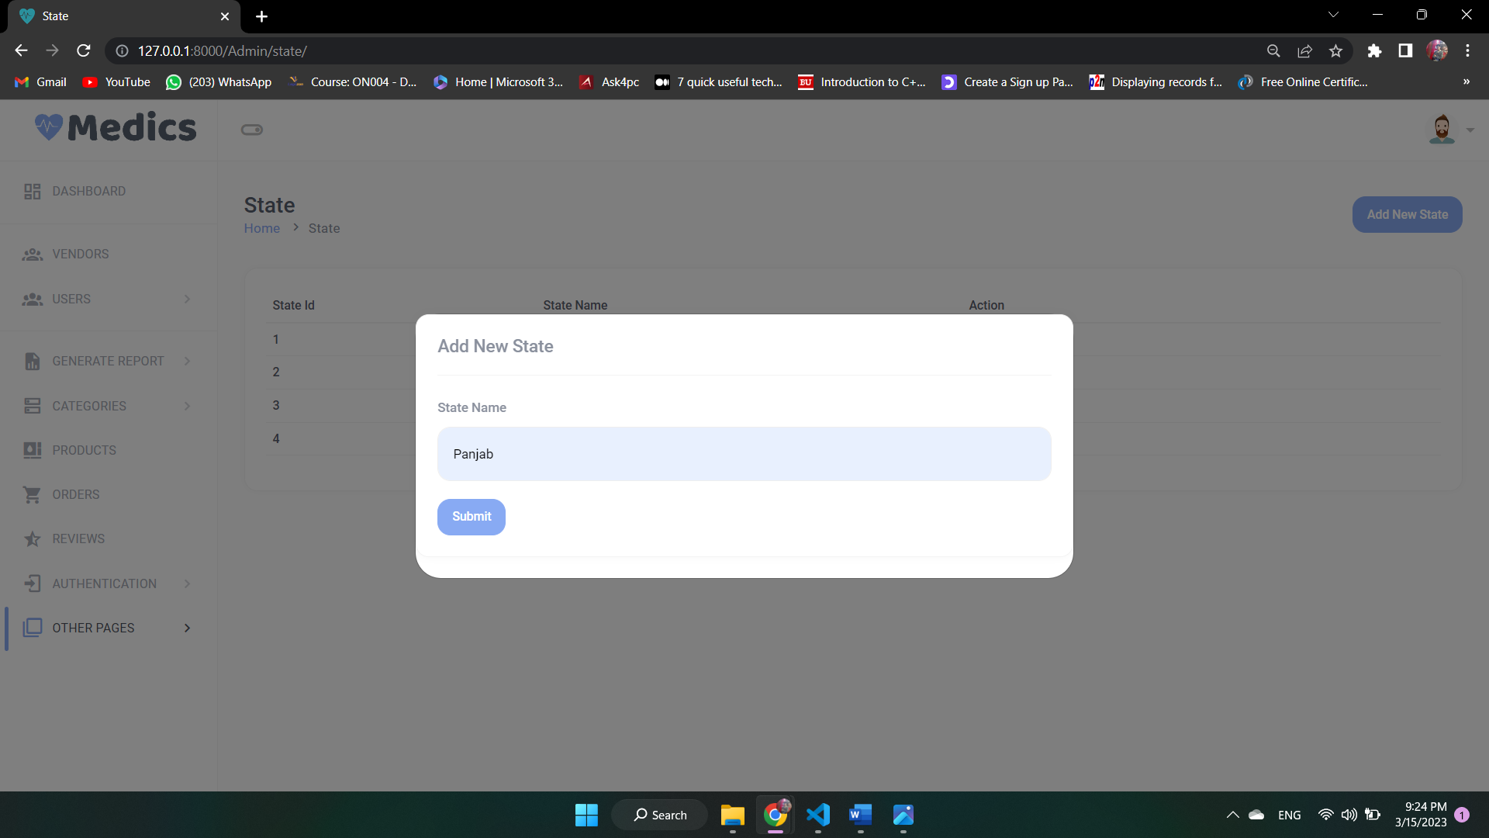
Add States

Slide 62
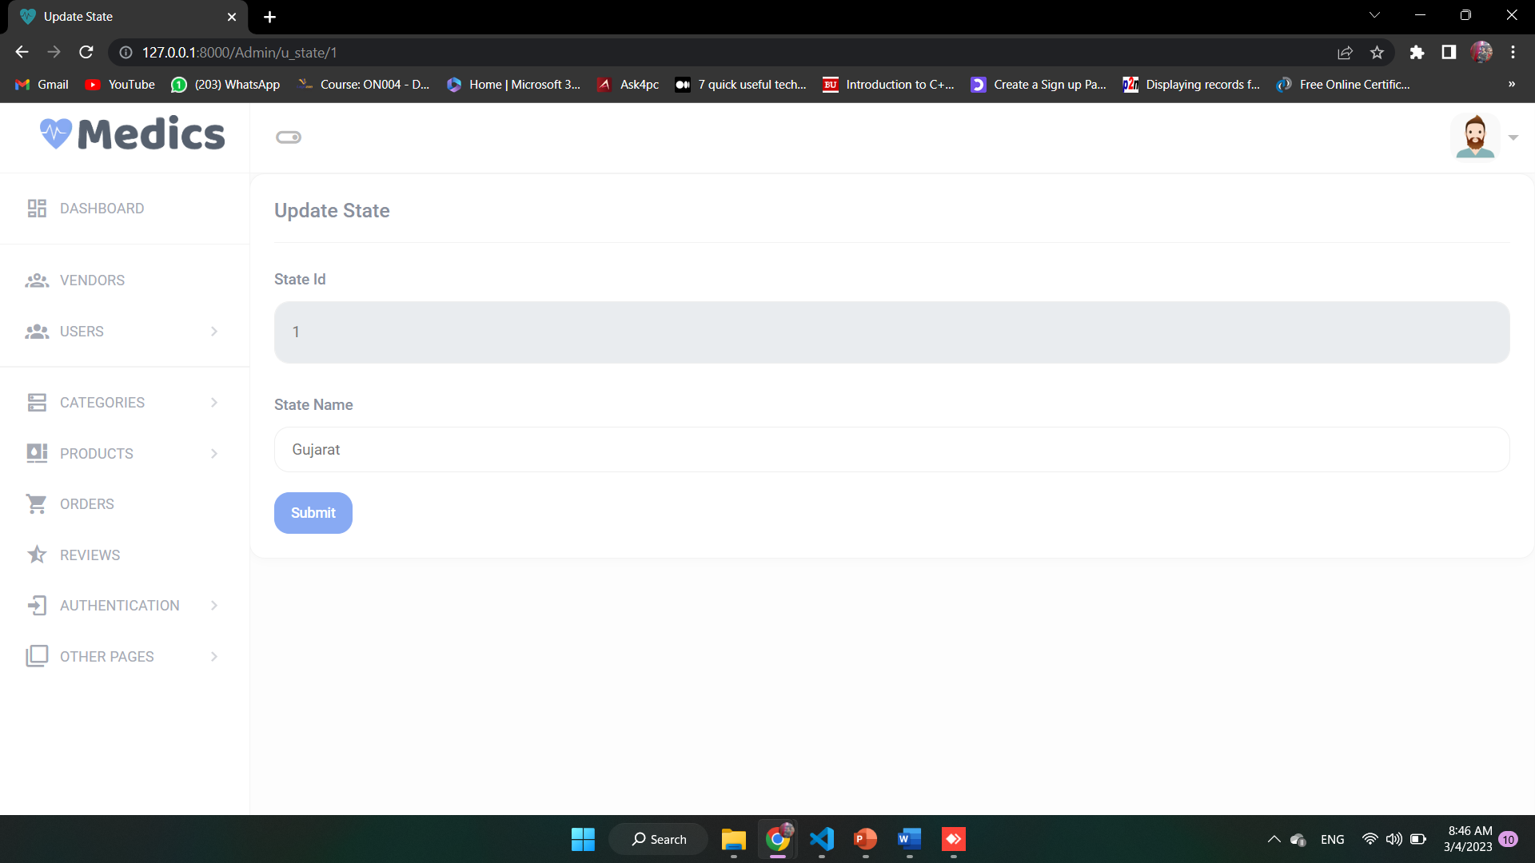
Update States

Slide 63
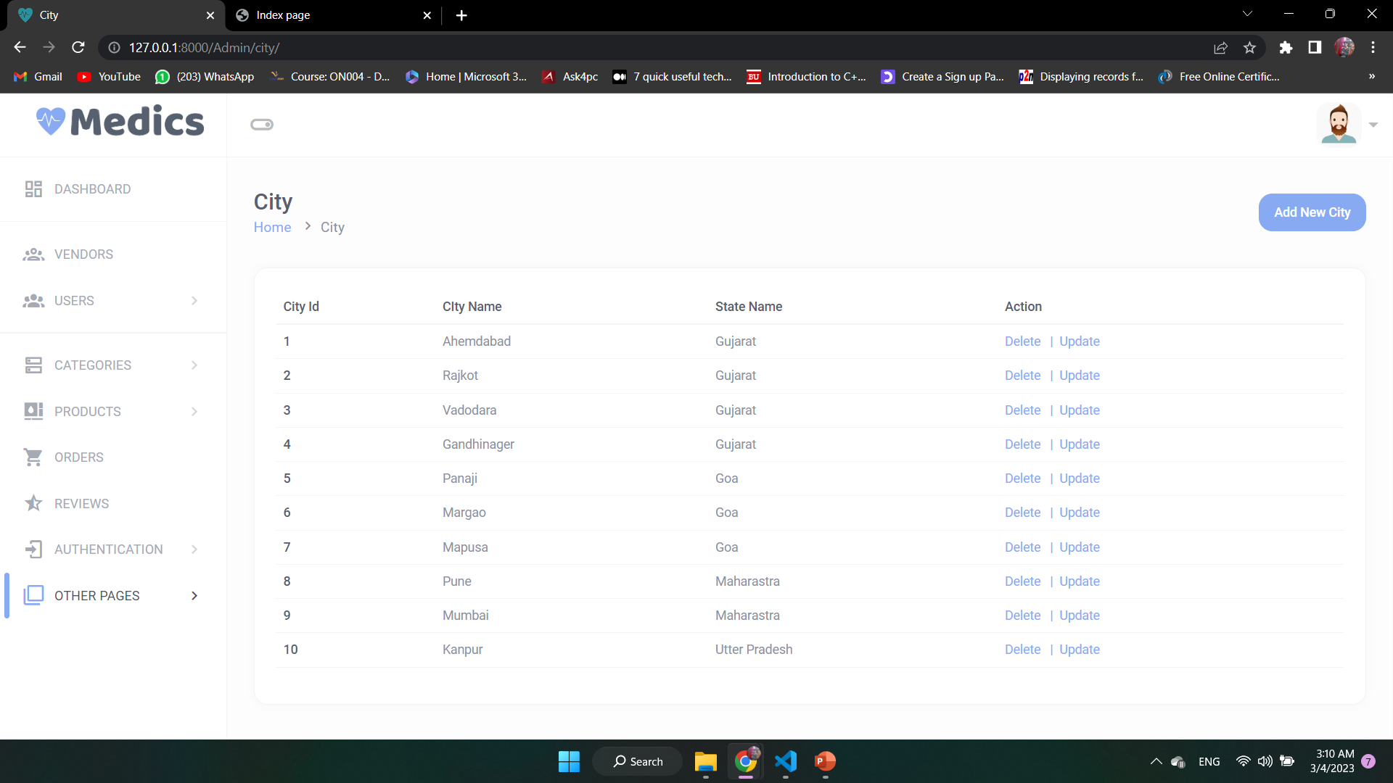
City

Slide 64
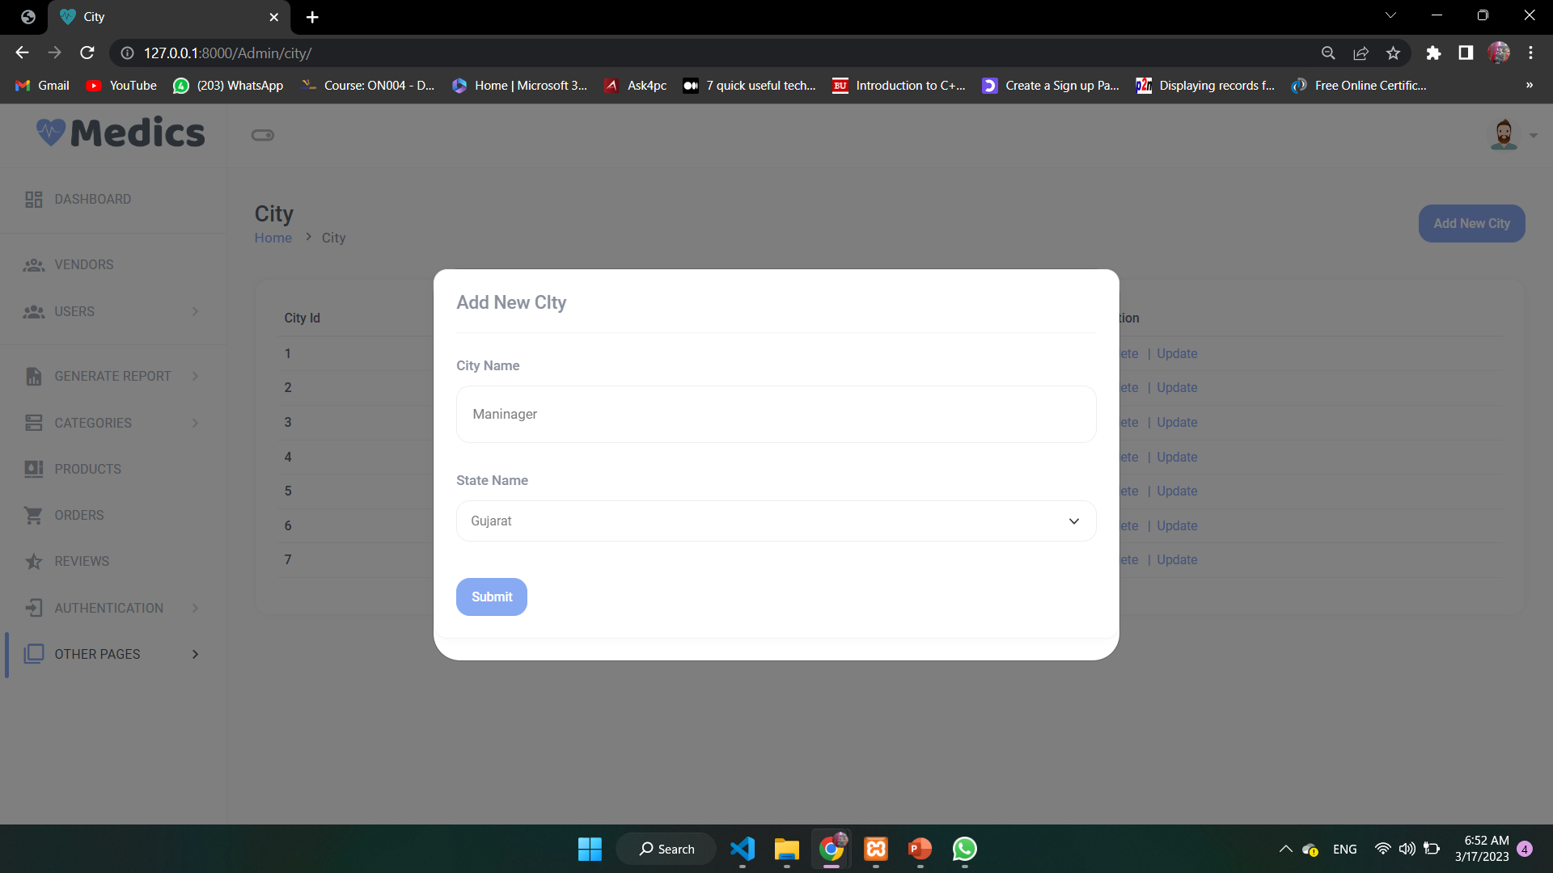
Add City

Slide 65
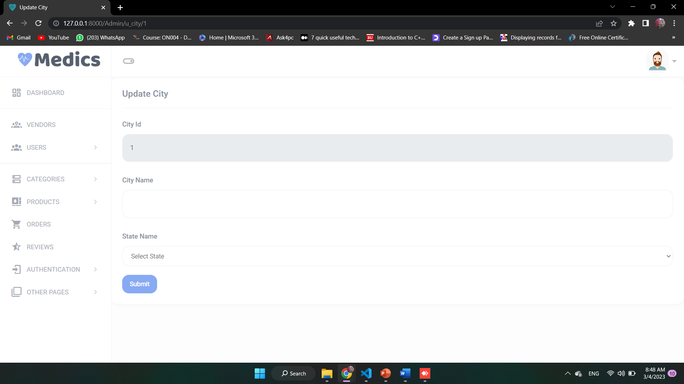
Update City

Slide 66
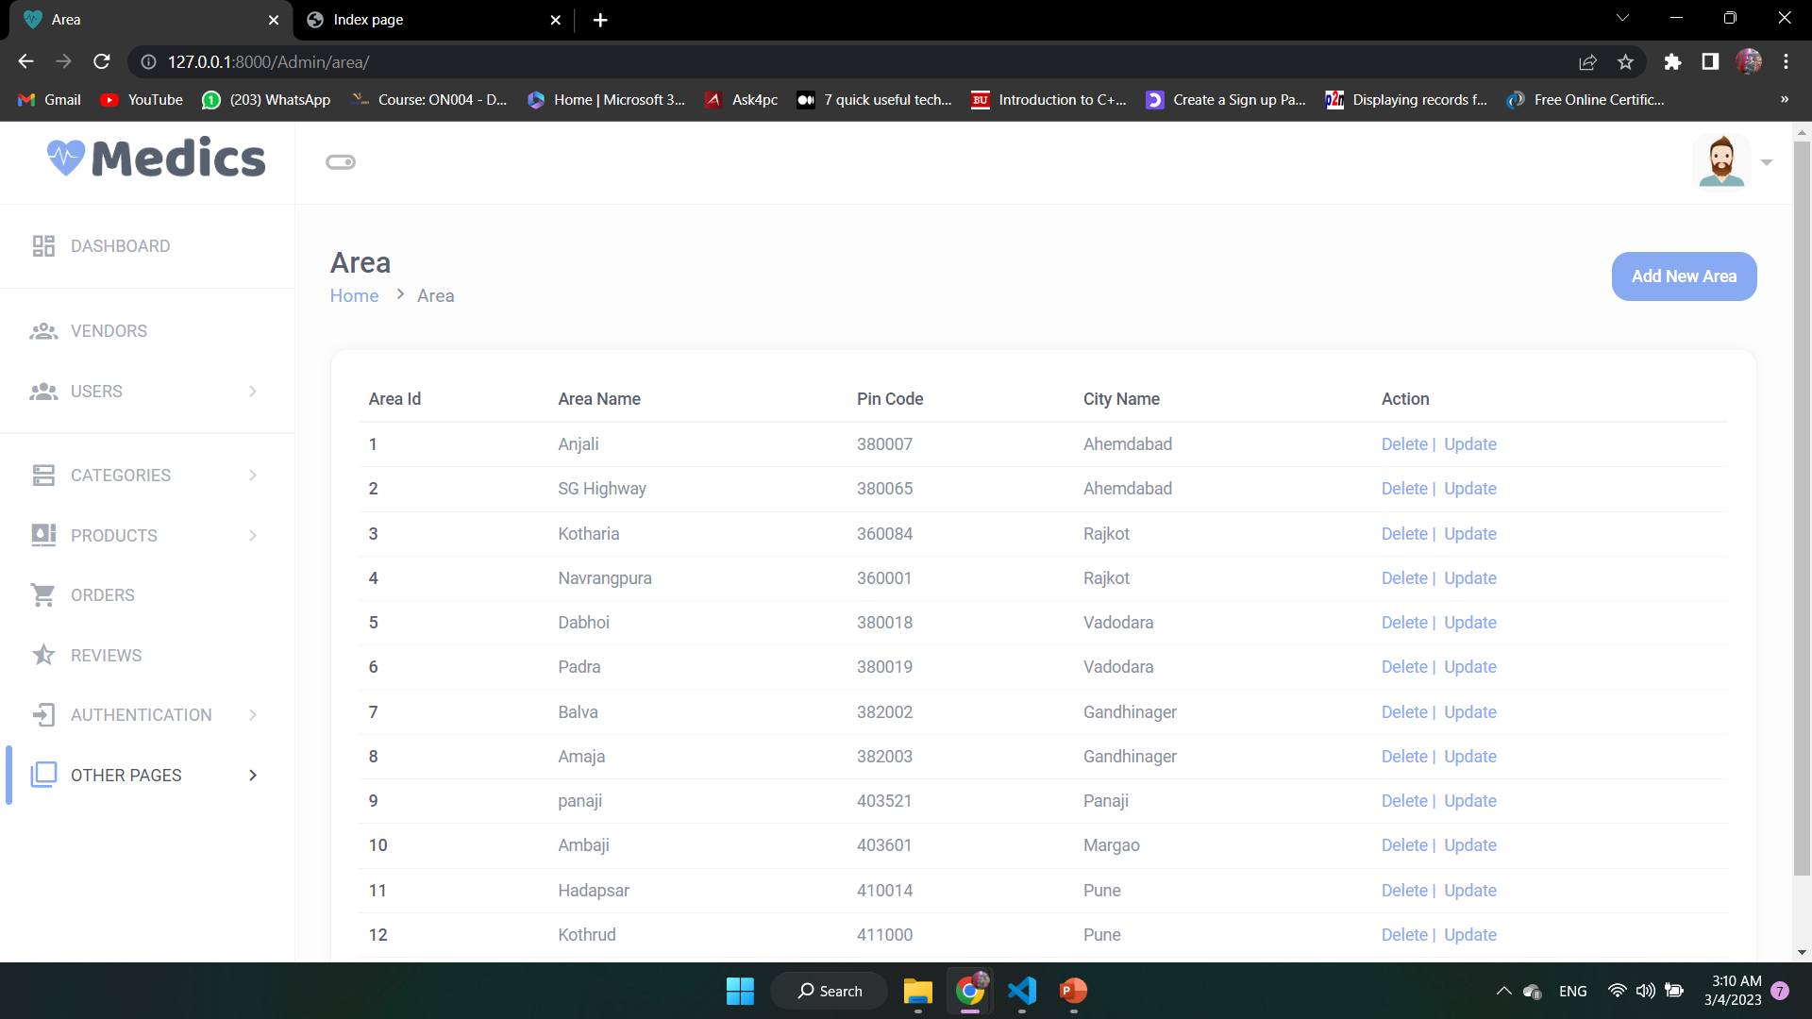
Area

Slide 67
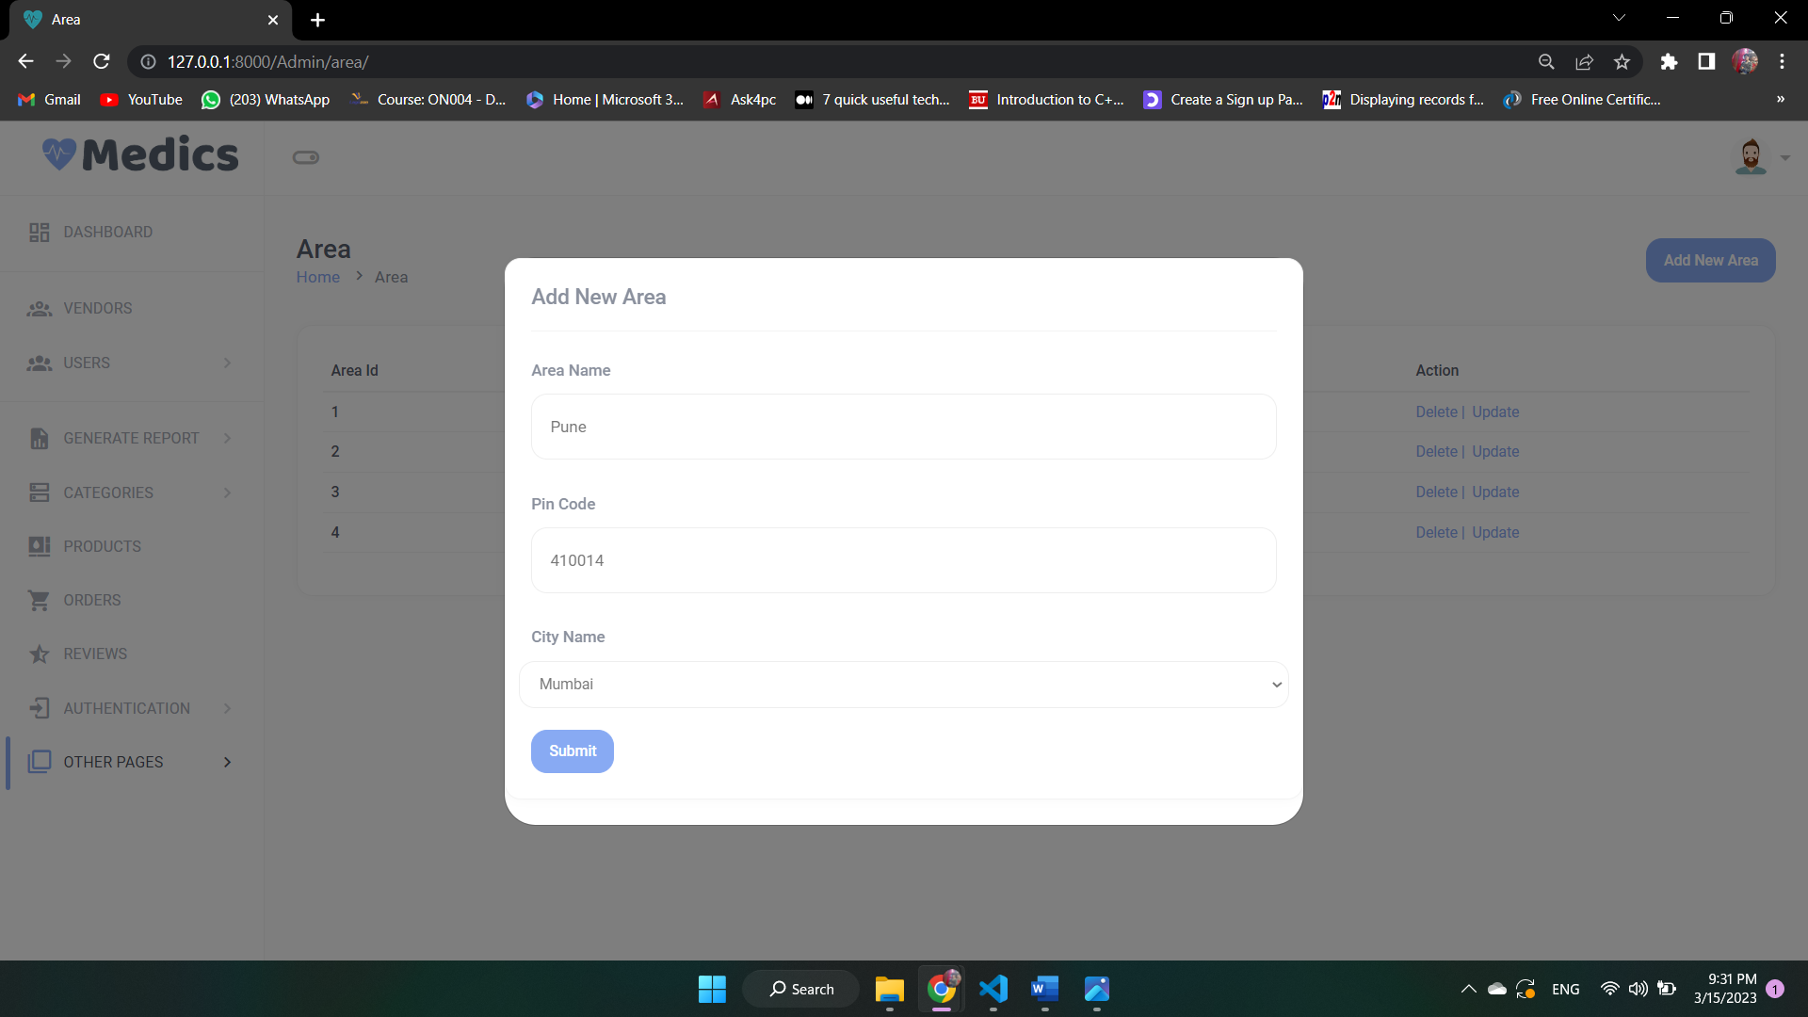
Add Area

Slide 68
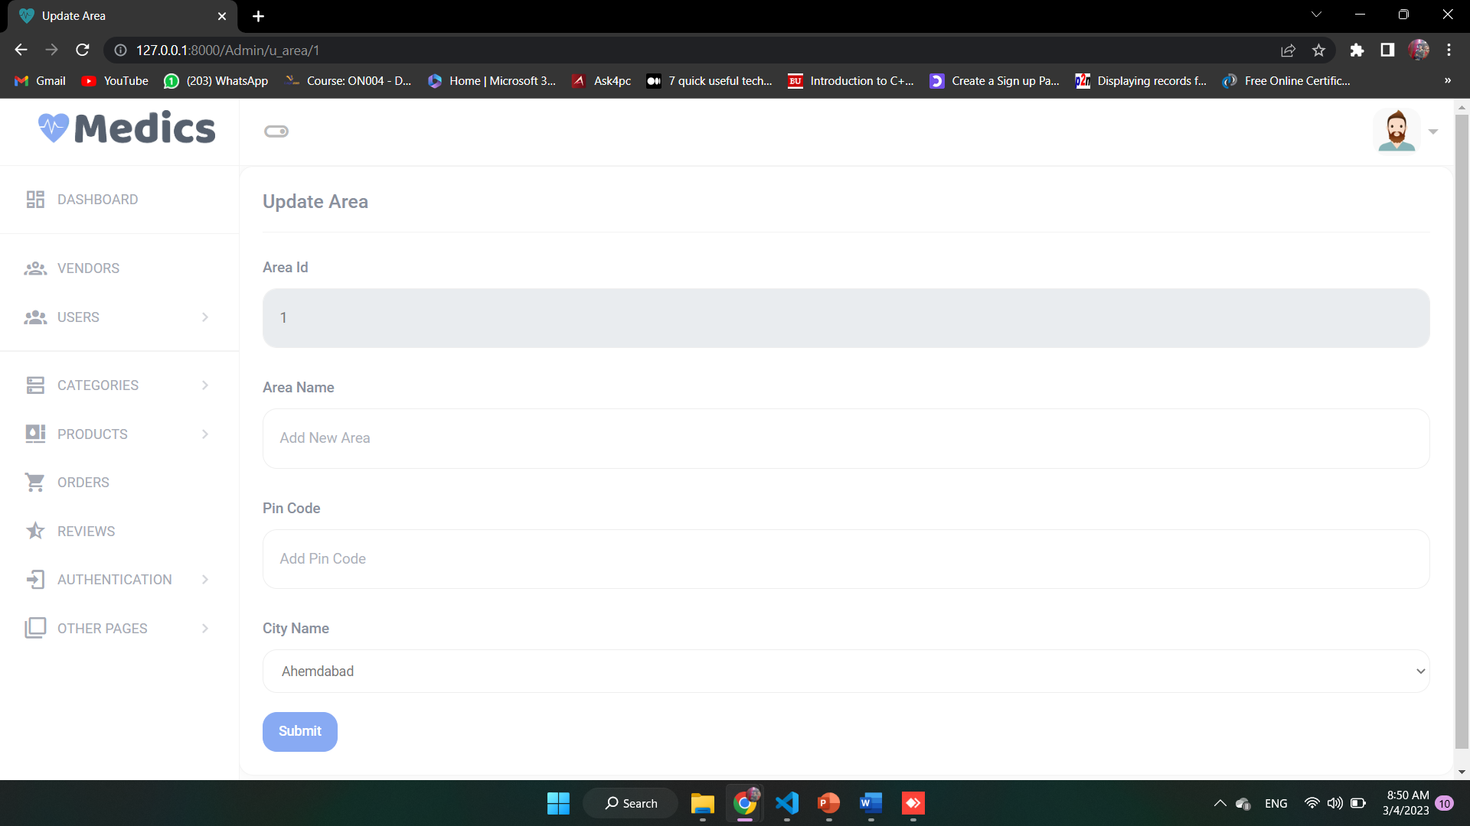
Update Area

Slide 69
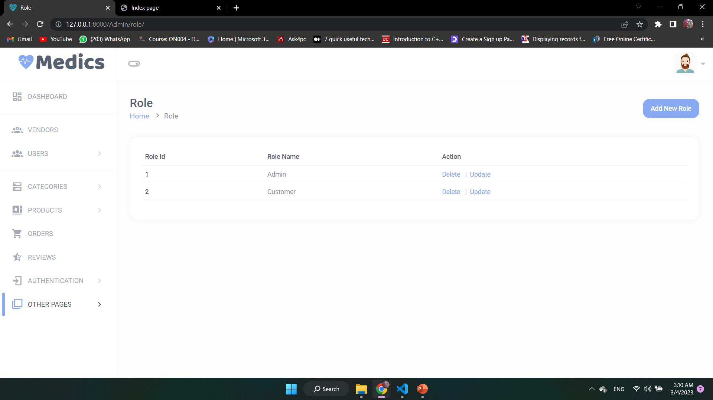
Role

Slide 70
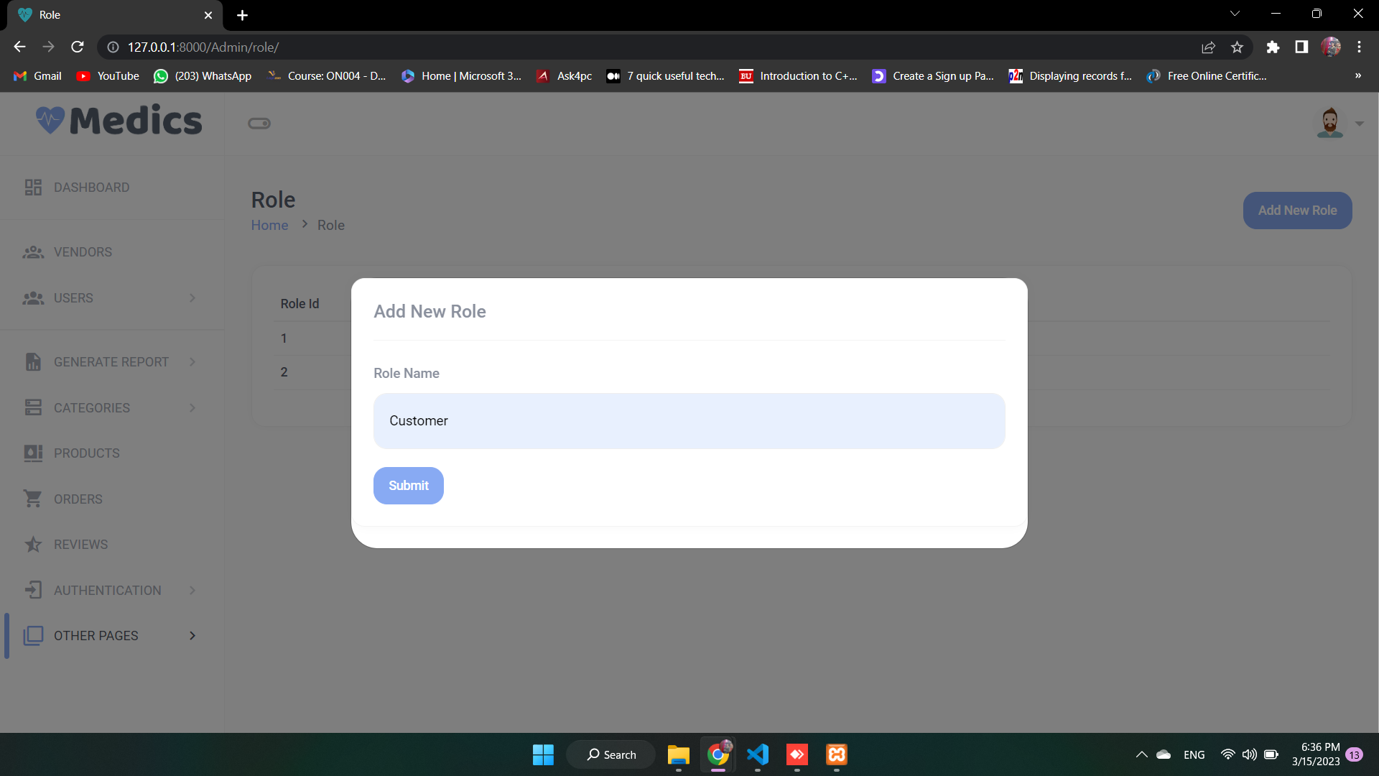
Add Role

Slide 71

Update Role

Slide 72
Vendor Login Error

Slide 73
Vendor Login Successfully

Slide 74
Vendor Forgot Password

Slide 75
Vendor Send OTP & New Password

Slide 76
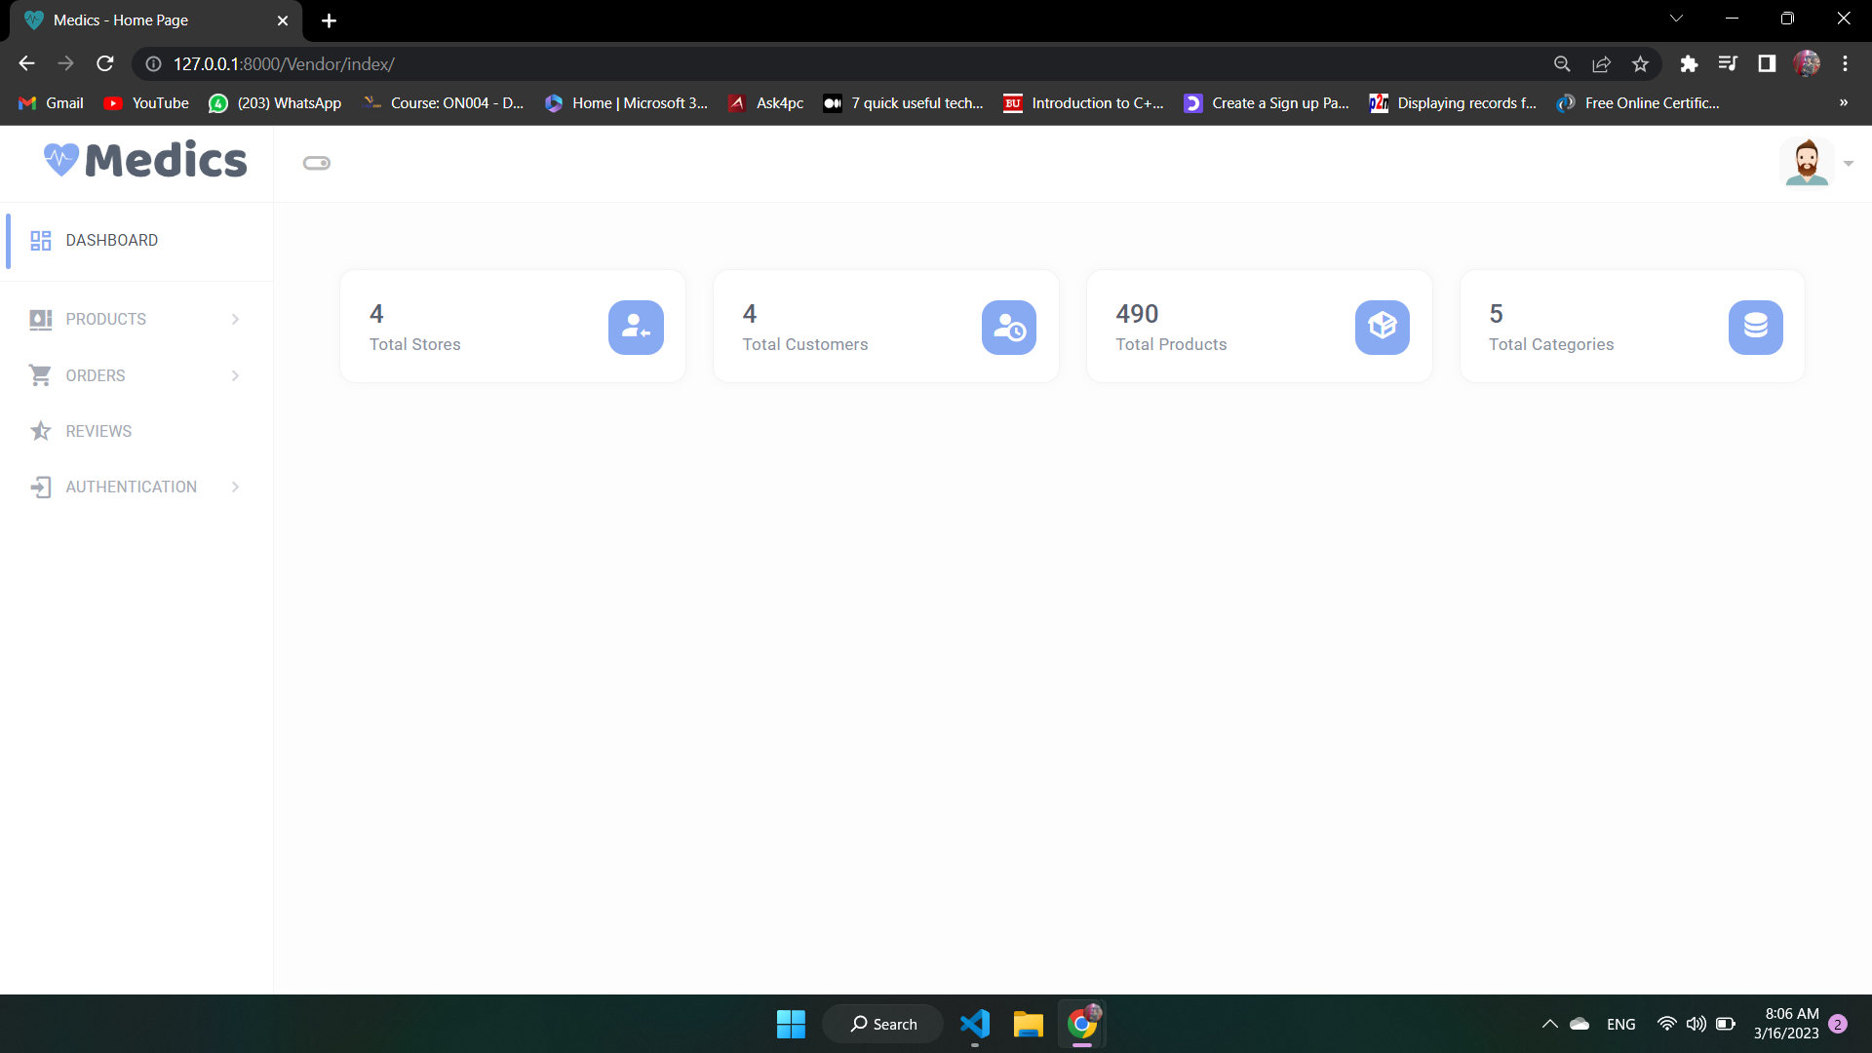
Dashboard Vendor

Slide 77
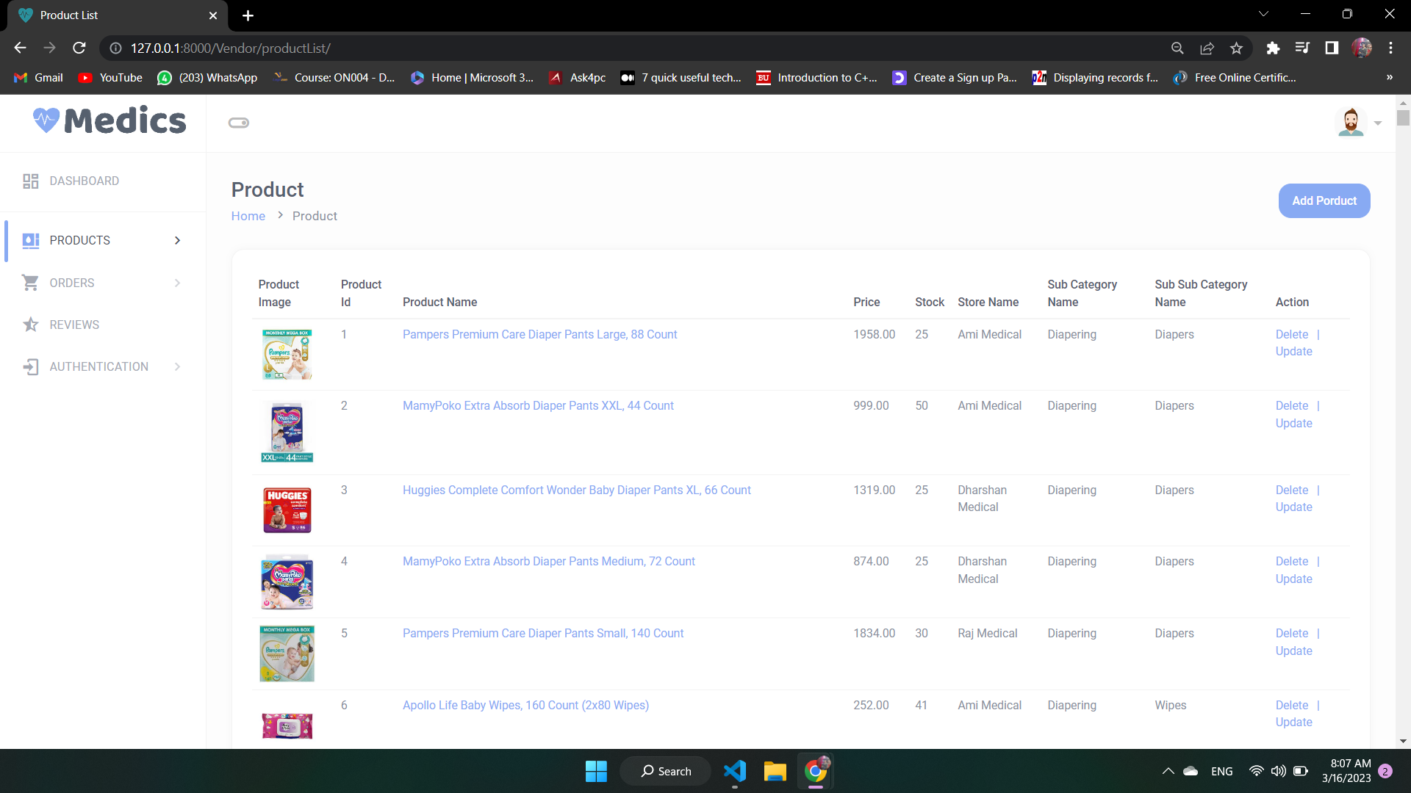
Product

Slide 78
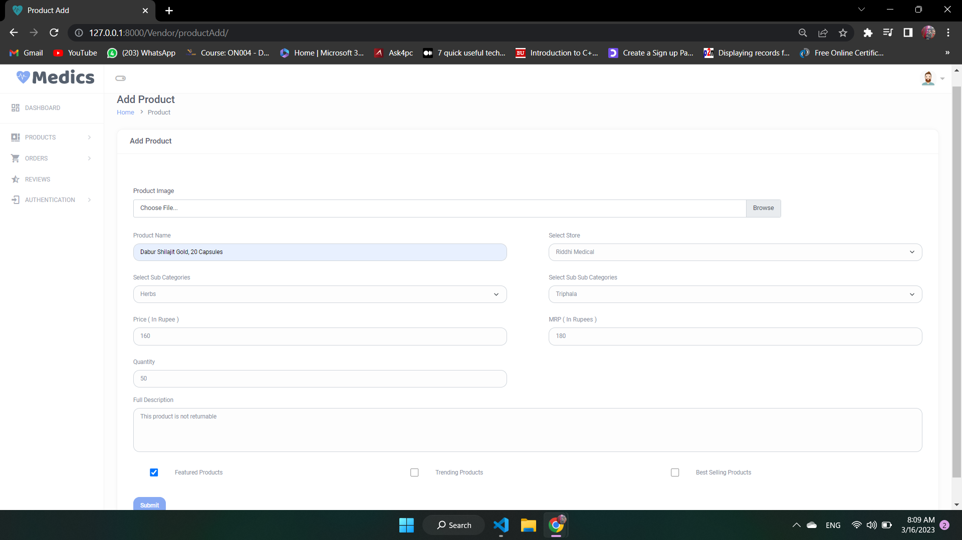
Add Product

Slide 79
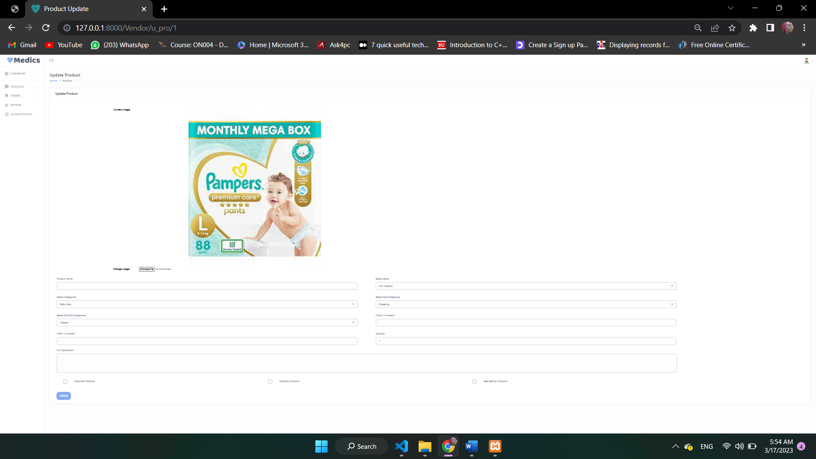
Update Product

Slide 80
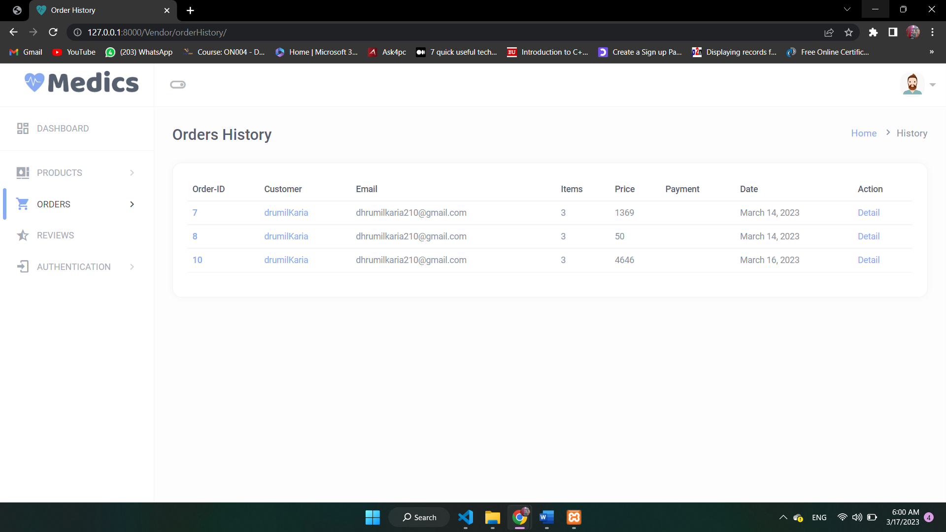
Orders

Slide 81
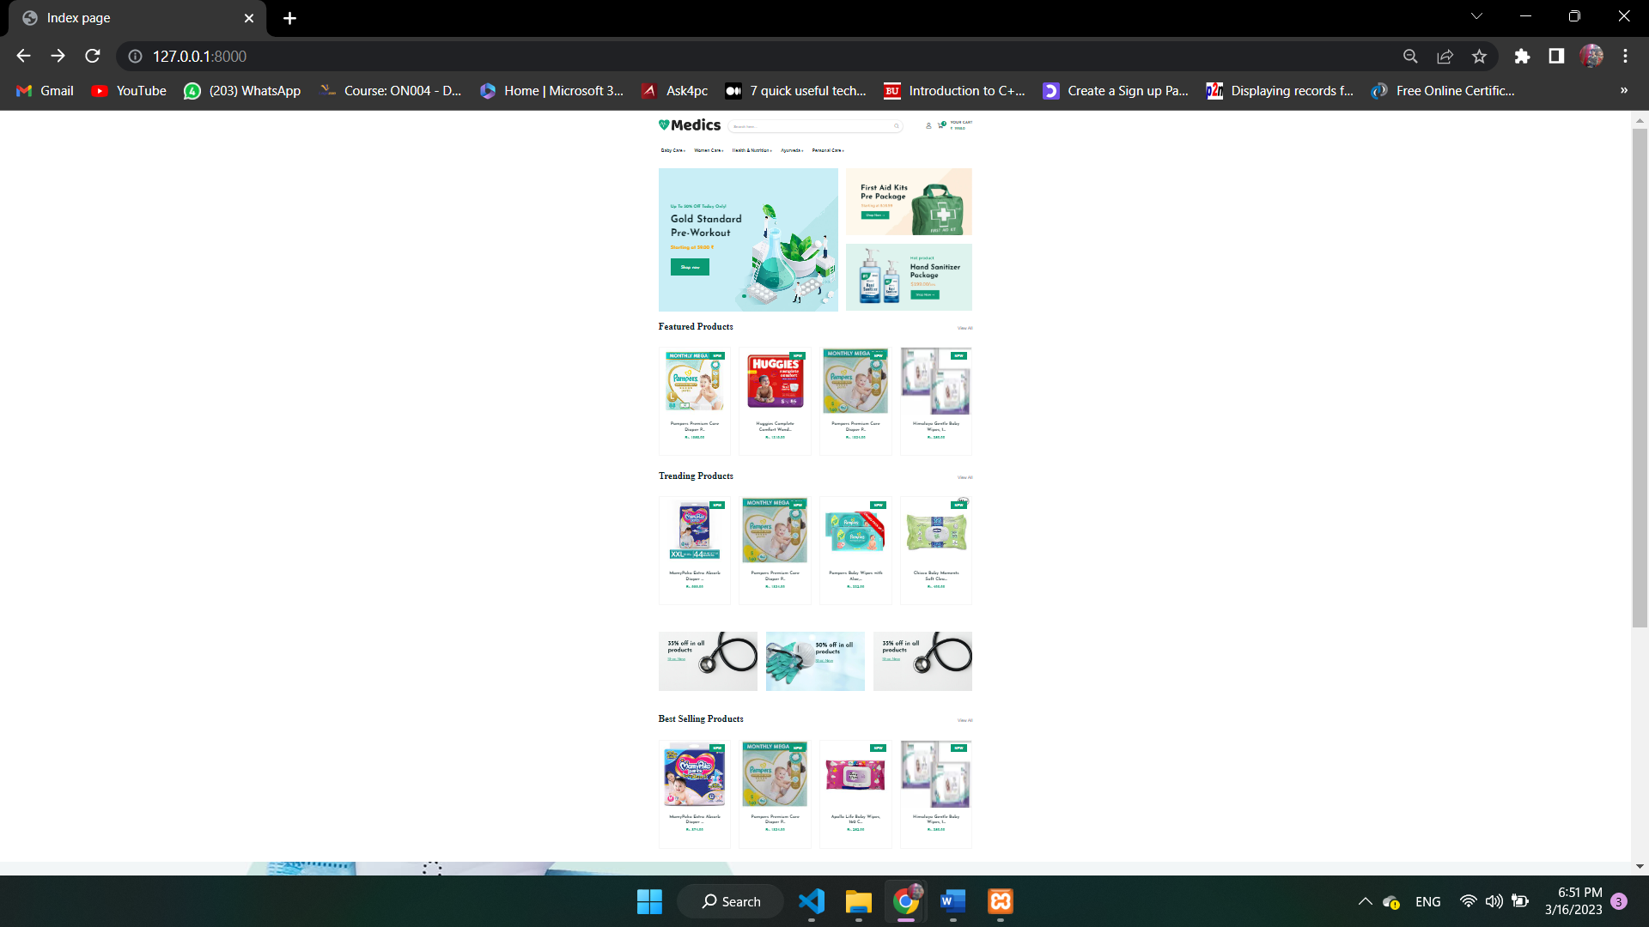
Index Page

Slide 82
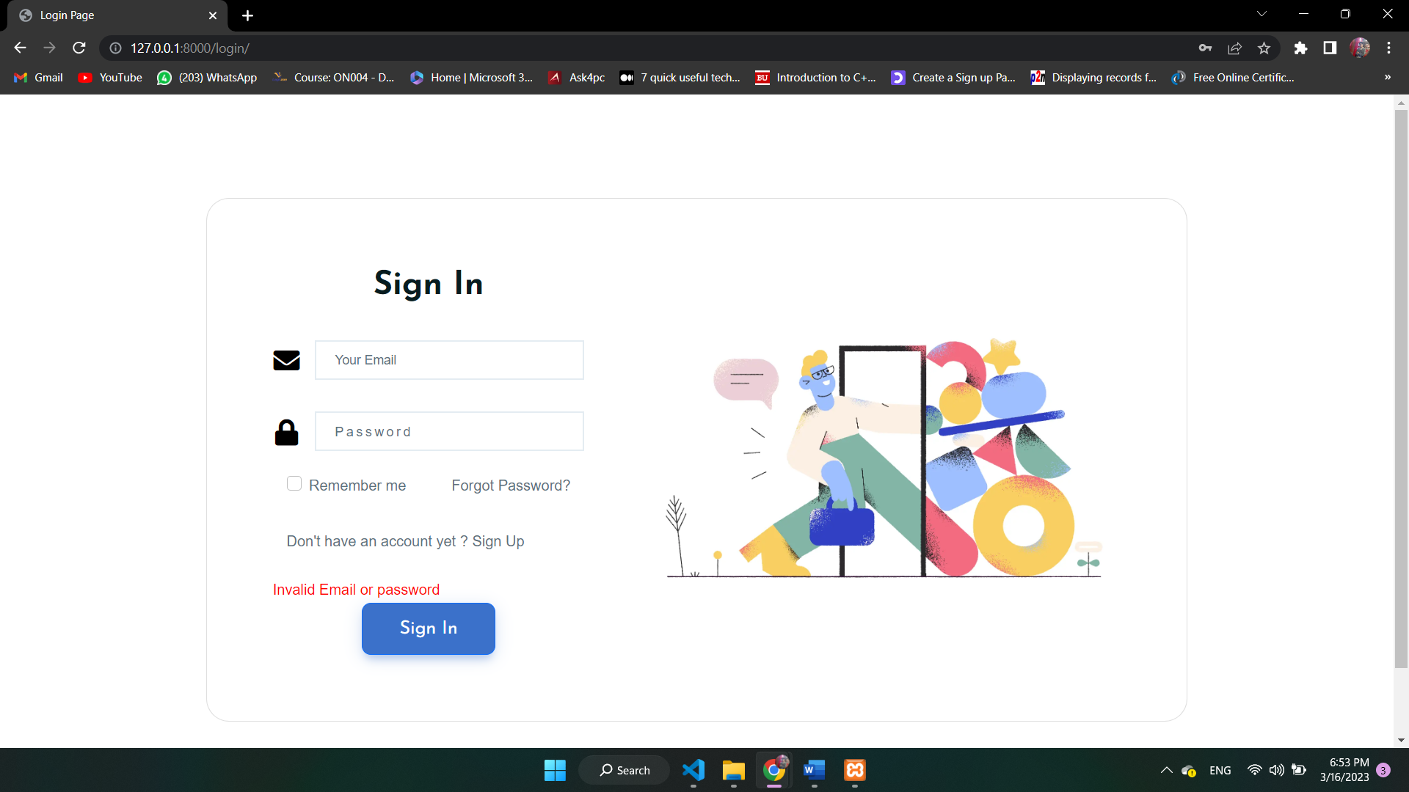
Login Error Page

Slide 83

Login Successfully

Slide 84

Forgot Password

Slide 85

Send OTP & Set New Password

Slide 86

User Registration

Slide 87

All Products

Slide 88

Product Detail

Slide 89

Product Reviews

Slide 90

Search Page

Slide 91

Searching Error

Slide 92

Add to Cart in Product

Slide 93

Checkout

Slide 94

Place Order

Slide 95

User Detail

Slide 96

Update User Detail

Slide 97

All Orders By User

Slide 98

Invoice

Slide 99
Future Enhancement
Order Tracking
Find the nearest Store
Prescription Upload
Coupon code
Cash on delivery
Delivery Boy

